Slide 1



NEOSPACE HACKATHON
New Ways of Working
Student Playbook
Hackathon guidebook and student reference
Dr. Loveneesh Rana
CEO, SPAIDER Space
loveneesh.rana@spaiderspace.com
1
Notes:
This playbook supports three working sessions of three hours each. Start with the challenge brief and your initial concept. Develop a solution that explains how the system operates, why customers would use it and how the team could implement it. Technology, regulation and business remain connected throughout the work. Each session ends with an expert review. The final outputs are a 10–15-page Technology Business Proposal and a pitch based on the same agreed solution. The appendix contains detailed steps and example prompts for use during the challenge.

Slide 2






Agenda
01
Introduction
02
SPAIDER platform
03
Session 1: Concept definition
04
Session 2: Integrated solution
05
Session 3: Proposal and execution plan
06
Proposal and delivery
Appendix: detailed steps, examples and prompt guide
2
Notes:
The guide covers the working approach, the SPAIDER tools and the three successive sessions. Each session has a process overview and a set of deliverables for expert feedback. The proposal and delivery section brings the work into one document and a pitch. Detailed process steps and prompt examples remain in the appendix. Use the prompts as starting points and adapt them to your concept, constraints and open questions. Regular team discussion is part of every stage.

Slide 3

Introduction
Working approach and session outputs
3
Notes:
The challenge develops one solution through three sessions. Understand the expected outputs and how team discussion, agents and expert feedback support the work. Technology, regulation and business stay connected throughout.

Slide 4







INTRODUCTION
People and agents working together
Technology, regulation and business progress in parallel
Technology
Regulation
Business
People + agent
People + agent
People + agent
Define the system
Compare evidence
Find requirements
Assess implications
Explore the market
Shape the offer
One shared Project
Discuss findings. Agree decisions. Keep evidence together.
4
Notes:
Team members can investigate technology, regulation and business together or divide those areas among themselves. In either arrangement, use the Knowledge Agent with at least one teammate and discuss the findings before accepting a conclusion. Keep agreed results in one shared Project so that the whole team can review them. Separate conversations may explore different questions, so bring important decisions back into the common working record. People remain responsible for choosing between alternatives, checking assumptions and deciding what the solution should do.

Slide 5
INTRODUCTION
Three sessions, three checkpoints
Each session develops the same solution further
SESSION 1
SESSION 2
SESSION 3
Concept definition
Integrated solution
Proposal and
execution plan
Concept V1
Solution V2
10–15-page proposal
System sketch
Business model
R&D plan and budget
Initial research
Regulatory approach
Pitch draft
Five questions guide each checkpoint summary.
Use the summary to discuss progress and open questions with experts.
5
Notes:
Session 1 develops the initial concept into an operating scenario and system sketch, supported by early patent and market research. Session 2 uses expert feedback to refine the architecture, establish a working business model and clarify the regulatory approach by the sixth working hour. Session 3 continues to resolve open issues while Sagan helps develop the proposal, R&D plan and budget. Expert feedback follows each session. Update the same solution and working document throughout, rather than treating the reviews as separate exercises.

Slide 6

SPAIDER platform
Collaborative R&D and engineering with space-domain expert AI Agents
https://neospace.spaiderspace.com/
6
Notes:
The platform supports research, shared work and proposal development. Libraries provide research material, the Knowledge Agent helps investigate questions and Projects organise team work. Sagan supports proposal development in Session 3. The team reviews and agrees the outputs throughout.

Slide 7
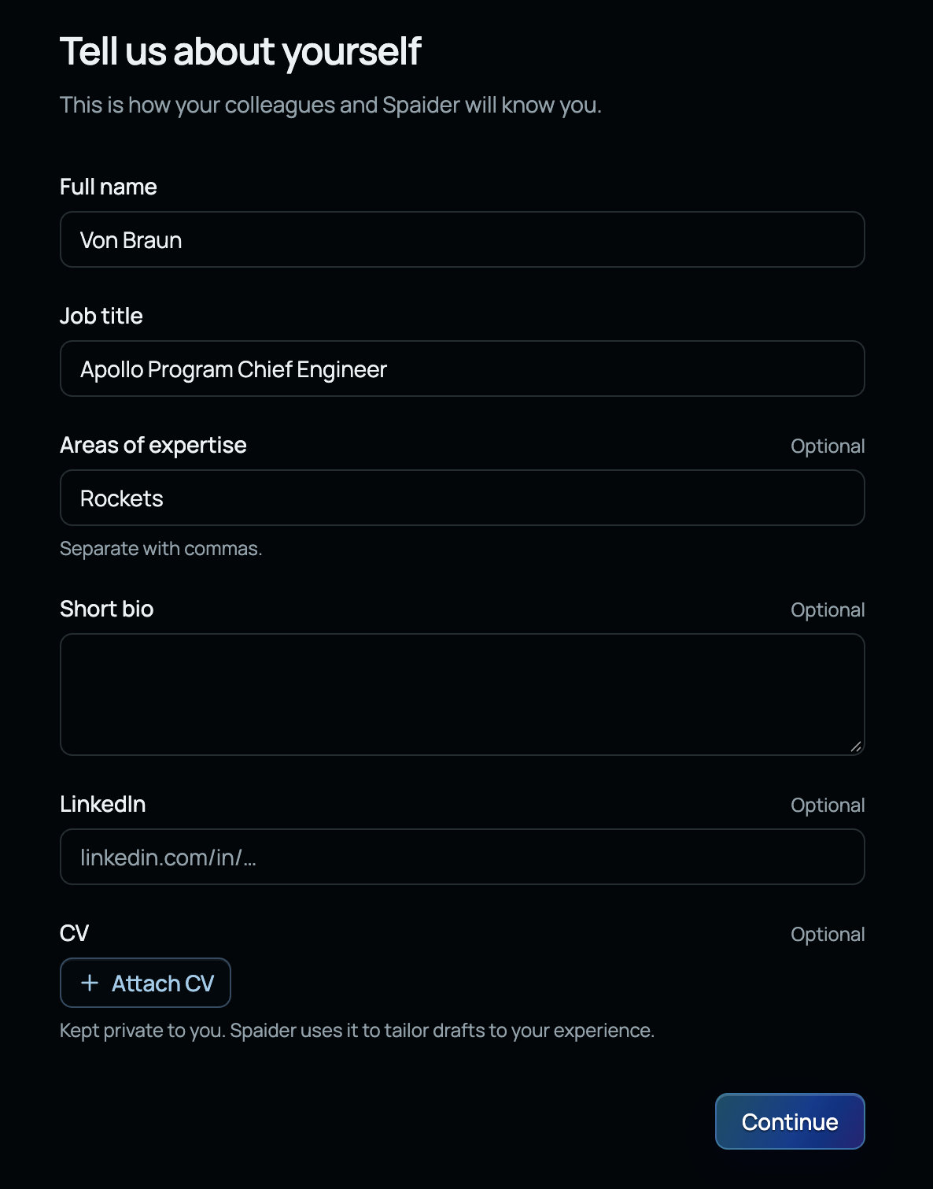
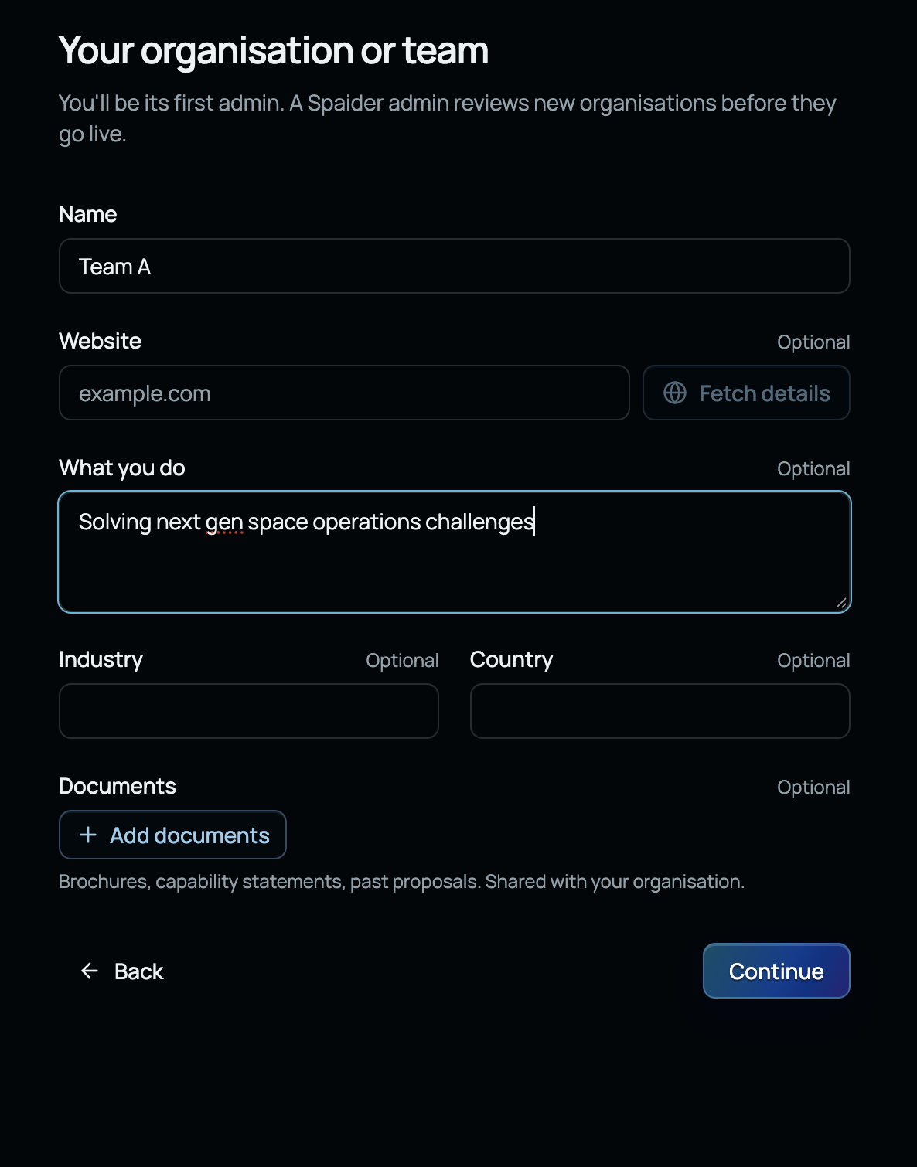
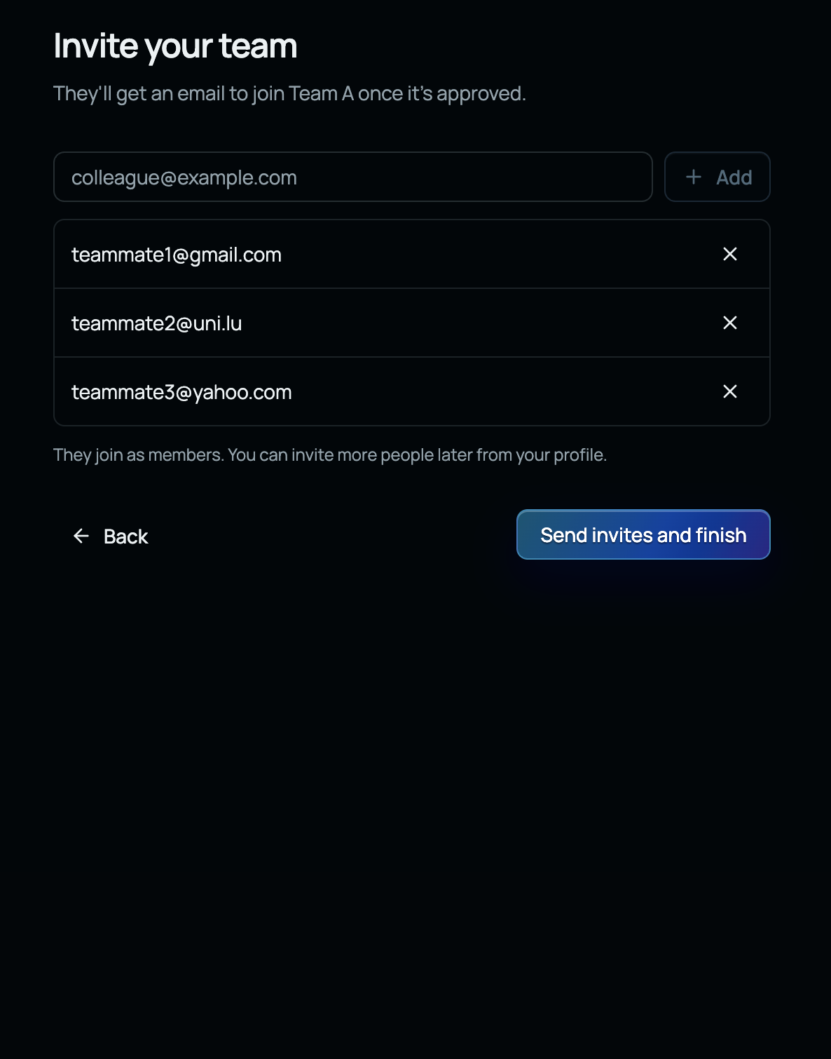
Getting started with SPAIDER
Sign Up → Create your Team/Org → Invite your teammates
Notes:
After logging in, identify the main areas of the workspace and confirm the team can access the platform. Understand where to find Libraries, Projects and the agent tools used in the challenge. Establish a shared place for the team to keep its work and confirm who will coordinate the common record.

Slide 8
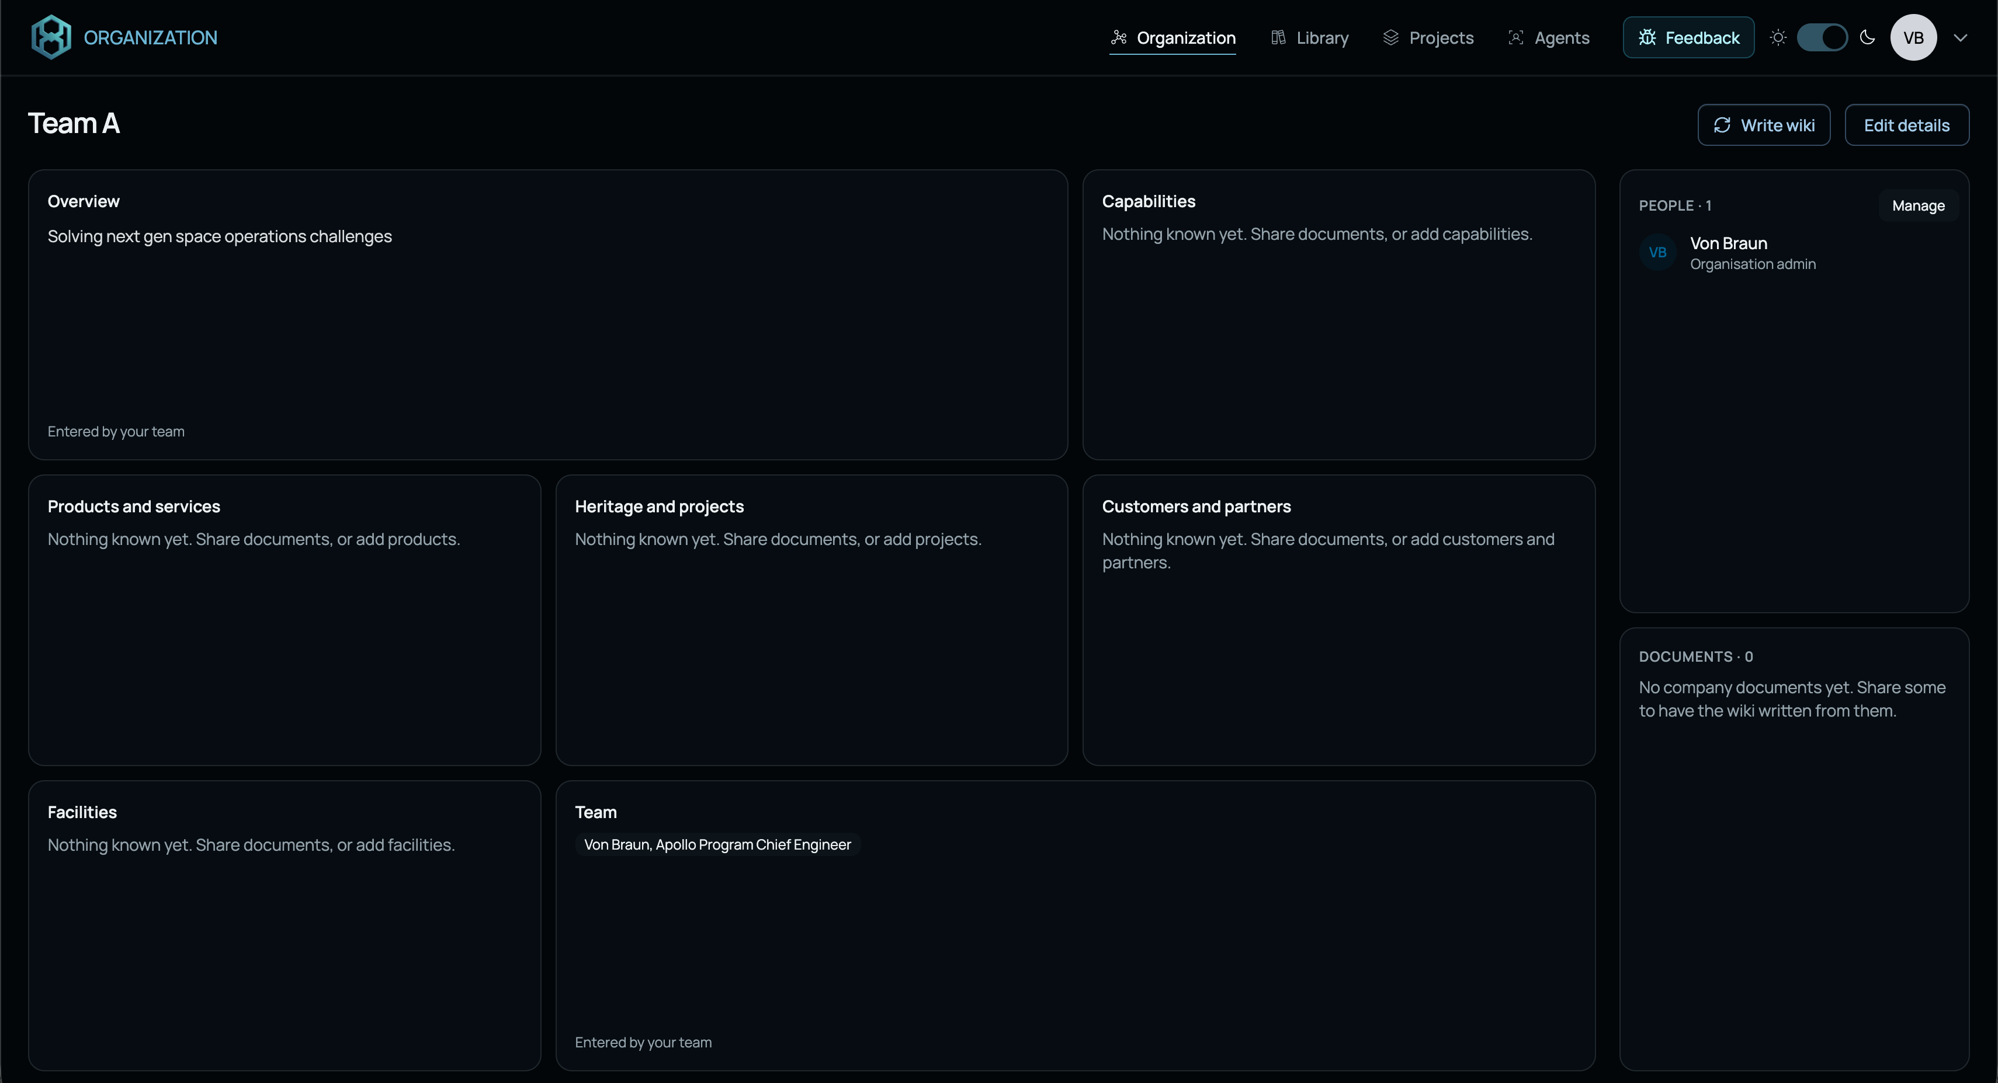
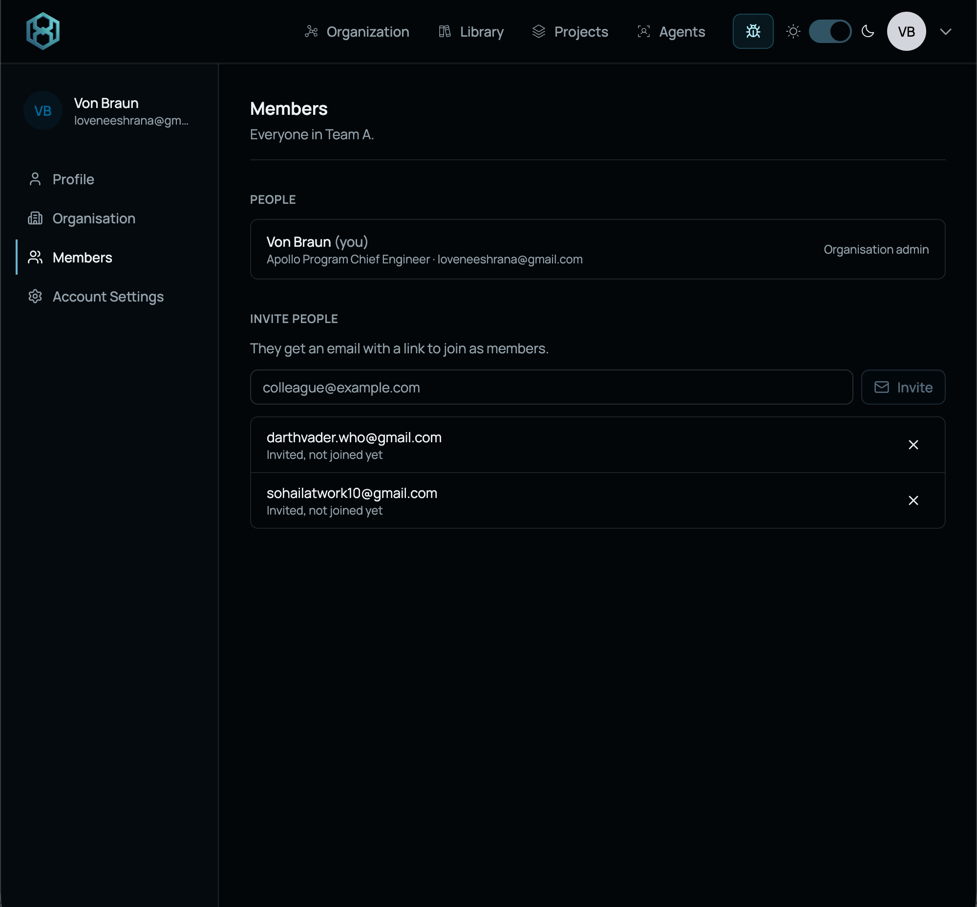
Adding/Inviting teammates

Slide 9
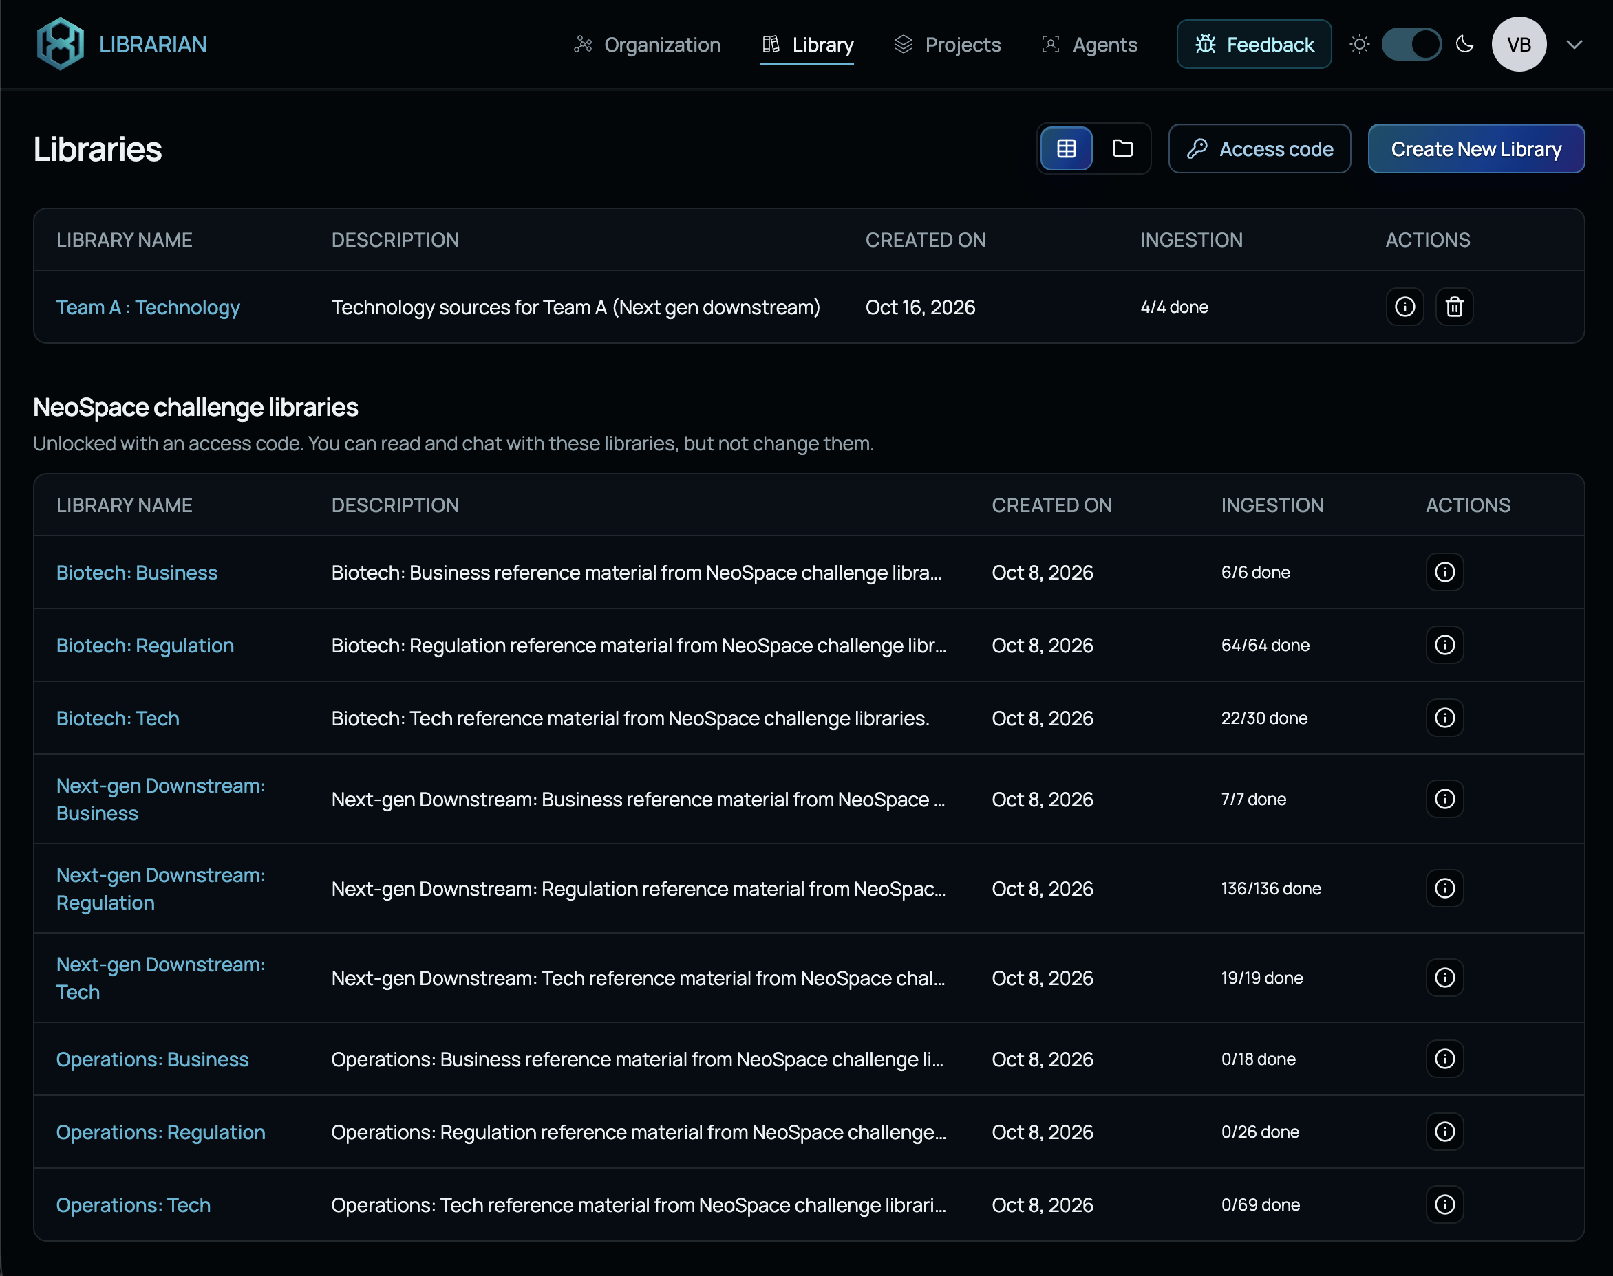
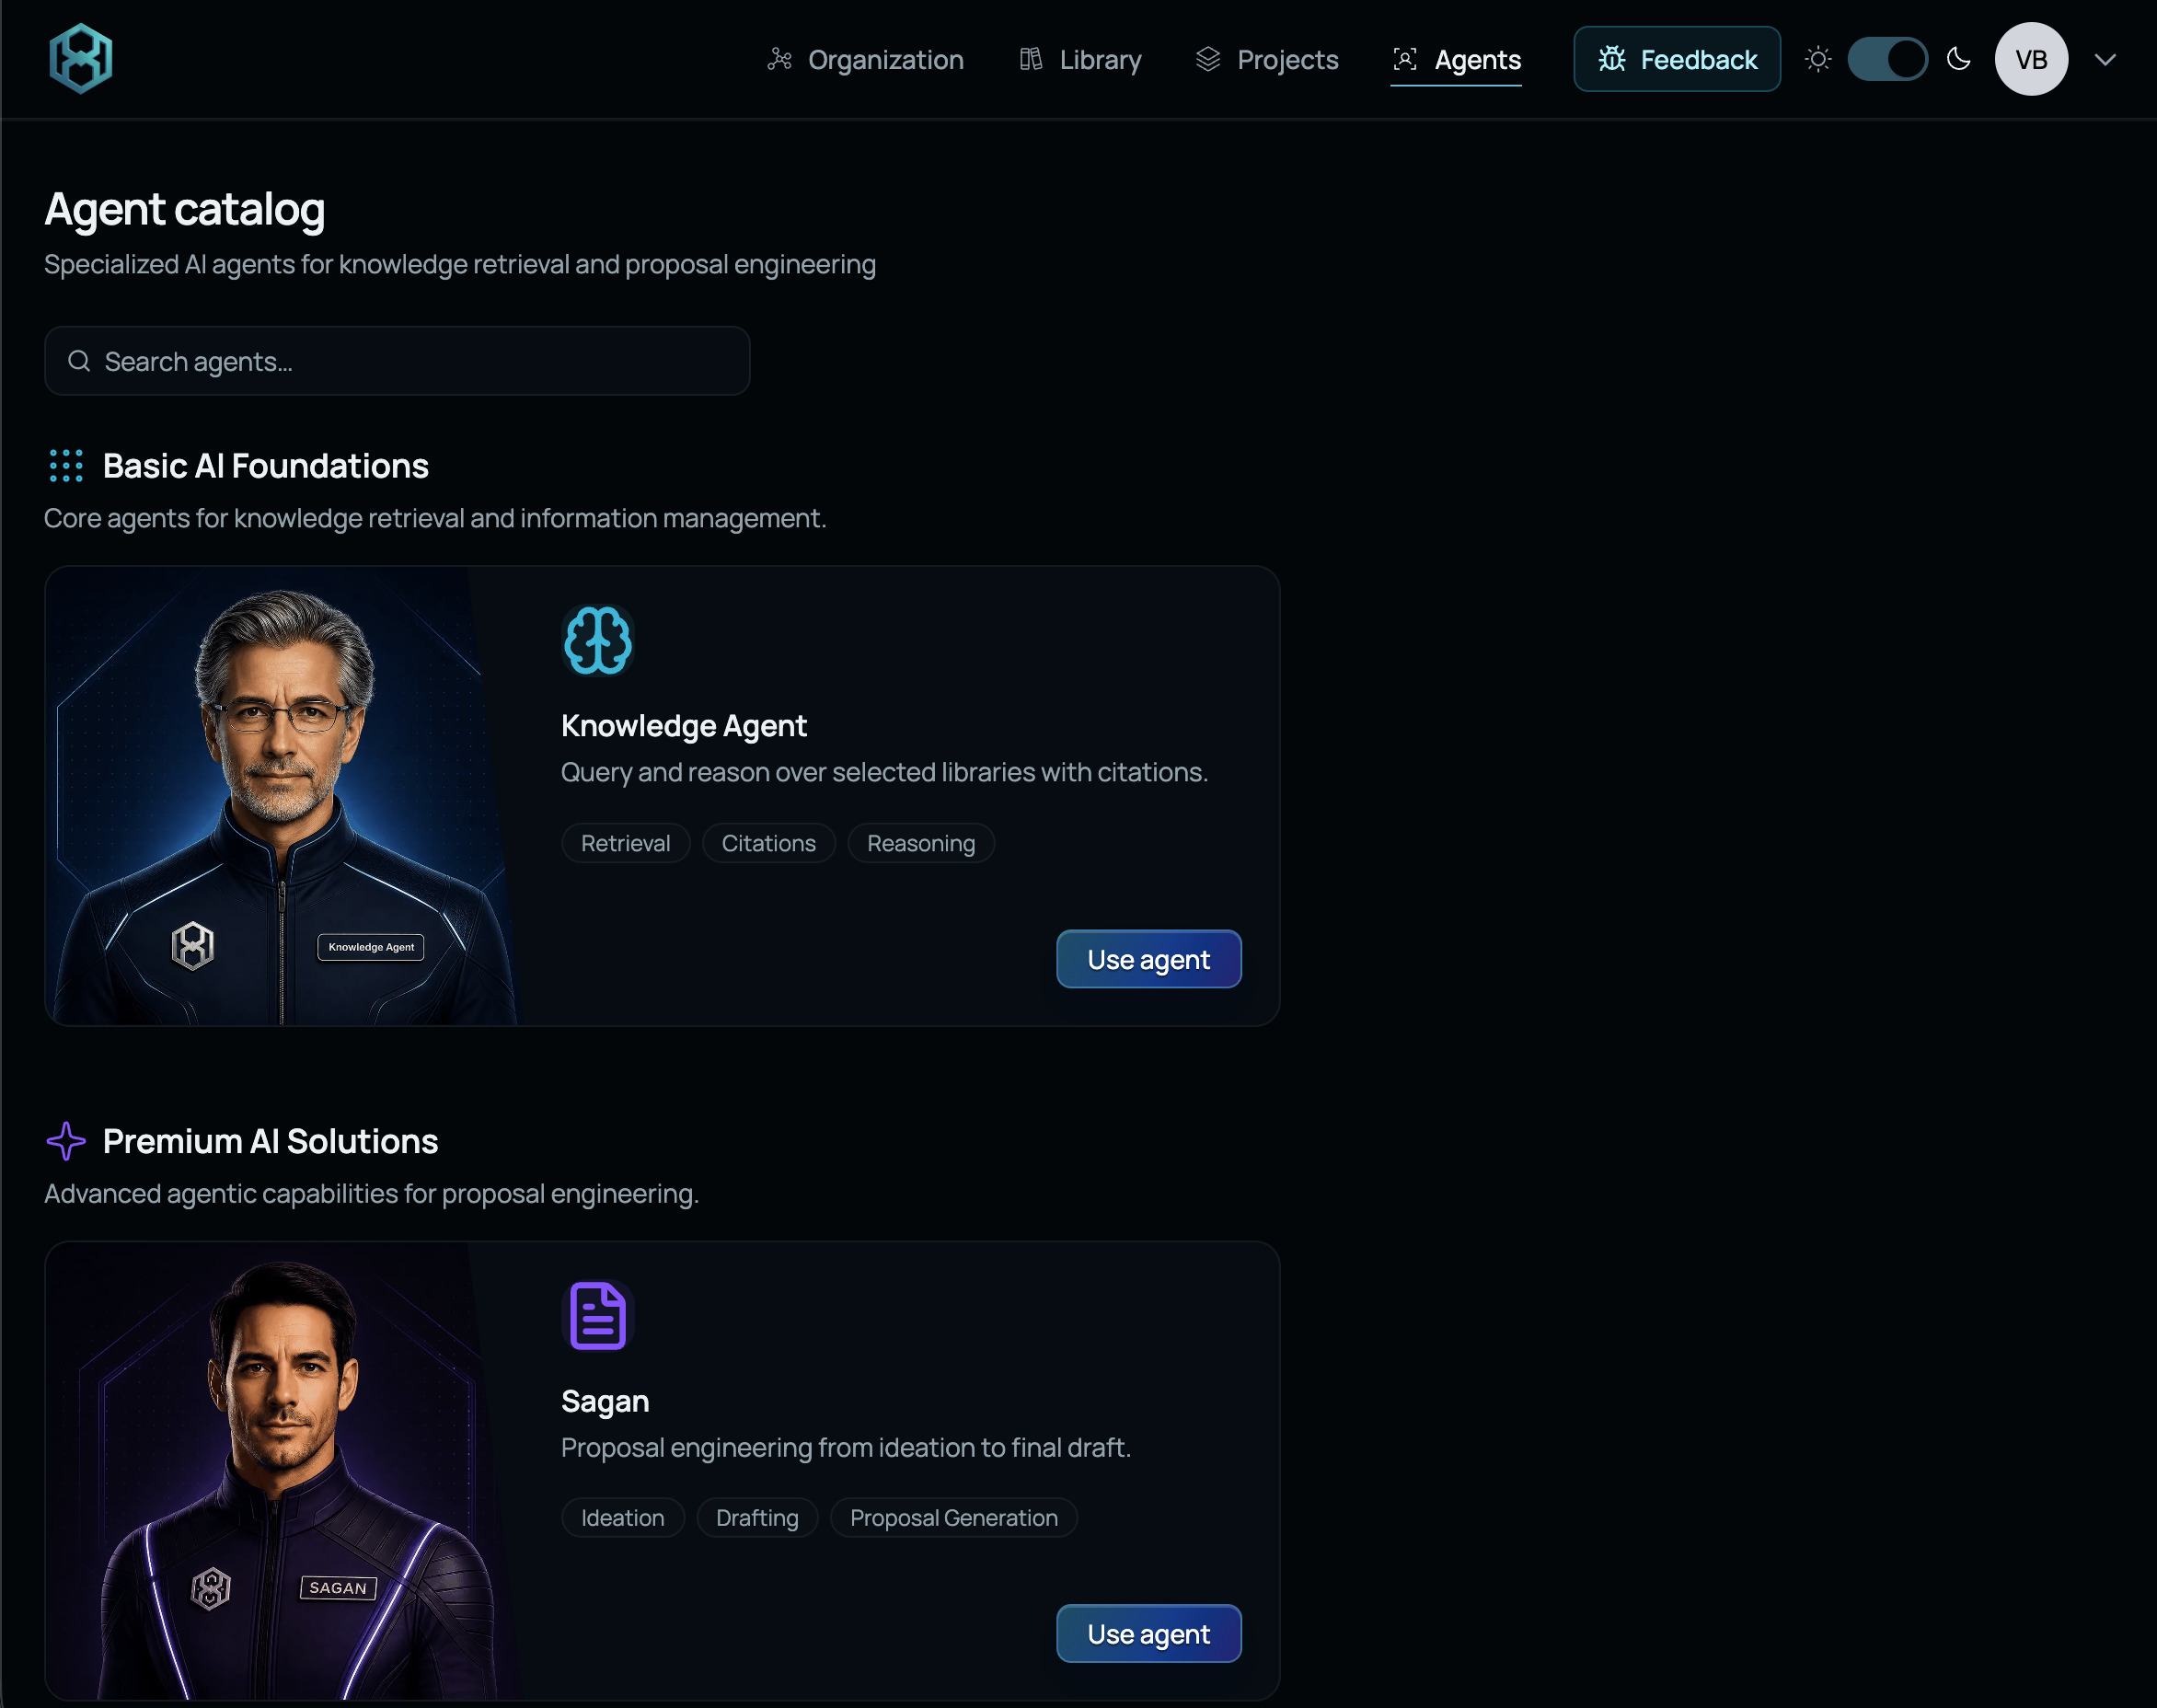
Key Elements of SPAIDER Platform
LIBRARIES
AGENTS
This is where your knowledge base lives
These are your assistants who work with/for you.
• Knowledge Agent : Knowledge work assistant
• Sagan : Expert proposal writer

Slide 10
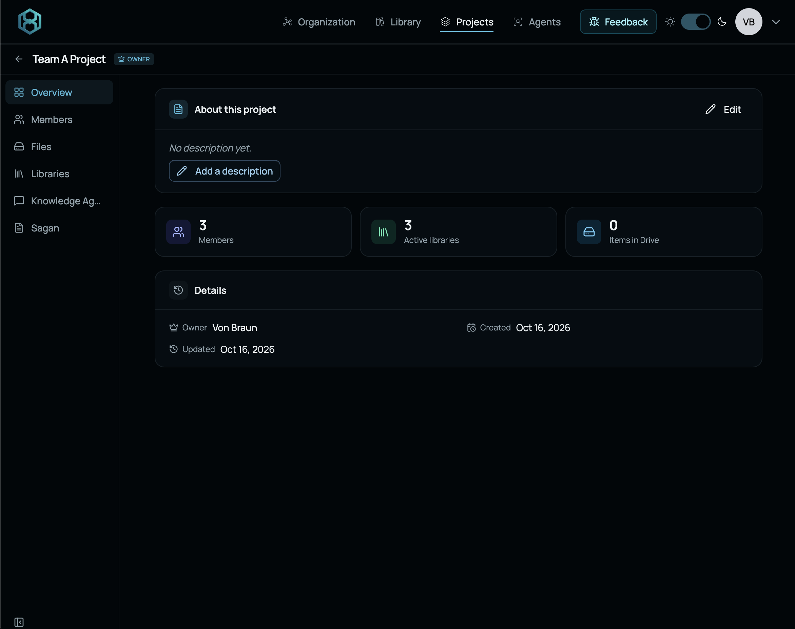
Key Elements of SPAIDER Platform
PROJECTS
This is where you can integrate your teammates, libraries and agents.
Teammates have read/write authority
All work inside the project is shared and visible to everyone in the project
You can collaborate with agents and teammates together
You can make any number of projects
  Split between Tech, Reg., Bussiness
  or
  Work all together in one project
Work with agents outside Projects is not shared and is your individual work

Slide 11
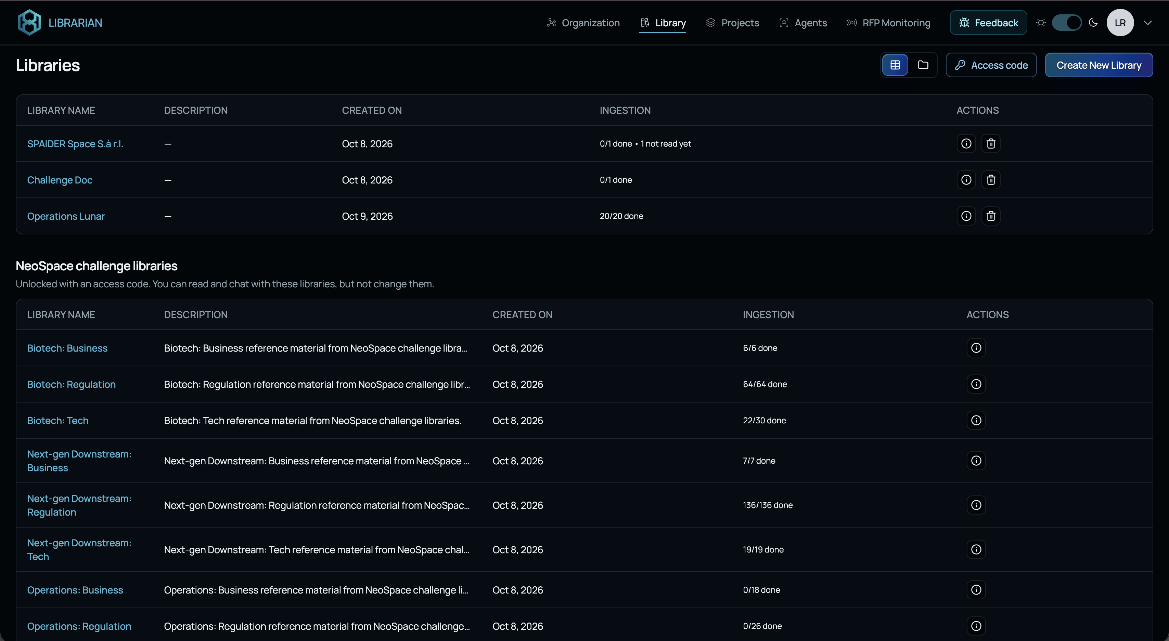




SPAIDER PLATFORM
Libraries
Shared source material for the selected challenge
Explore the challenge Libraries
Read research sources
Add papers and new sources
Check evidence and assumptions
Create New Library / Upload Documents
8
Notes:
Libraries bring together the source material for a challenge. Existing collections can support technical, regulatory and business research, while additional papers or documents can fill gaps. Read enough of the material to understand its relevance and limits. Compare the evidence with the assumptions in your concept. SPAIDER provides citations automatically, so example prompts can focus on the research question. Discuss uncertain or conflicting findings with teammates and record their implications for the solution.

Slide 12
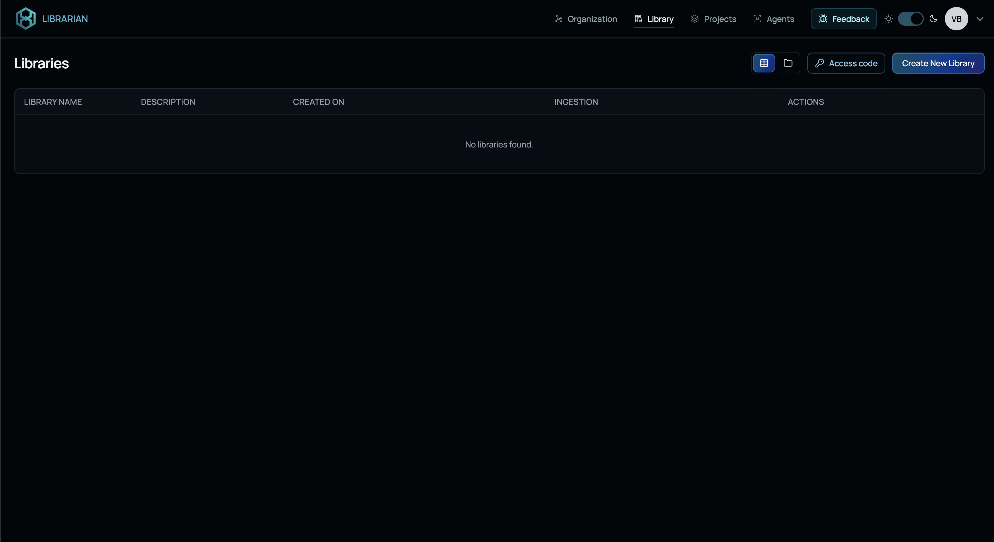
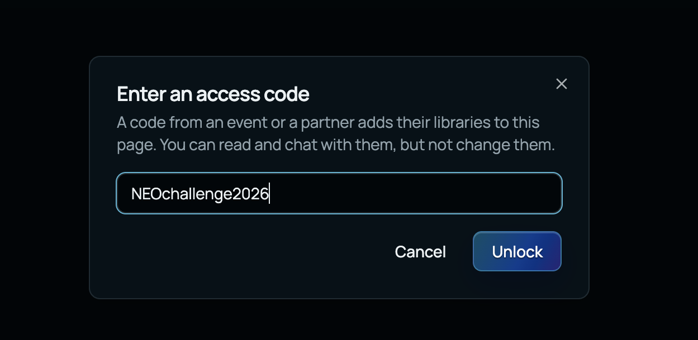
Getting started with Libraries
Access Public Libraries: Code “NEOchallenge2026”
Notes:
Existing challenge Libraries provide a starting point for research. Review what material is available and how it relates to the questions your team needs to answer. Additional documents can help fill specific gaps. The interface handles library selection, allowing prompts to focus on the research question.

Slide 13
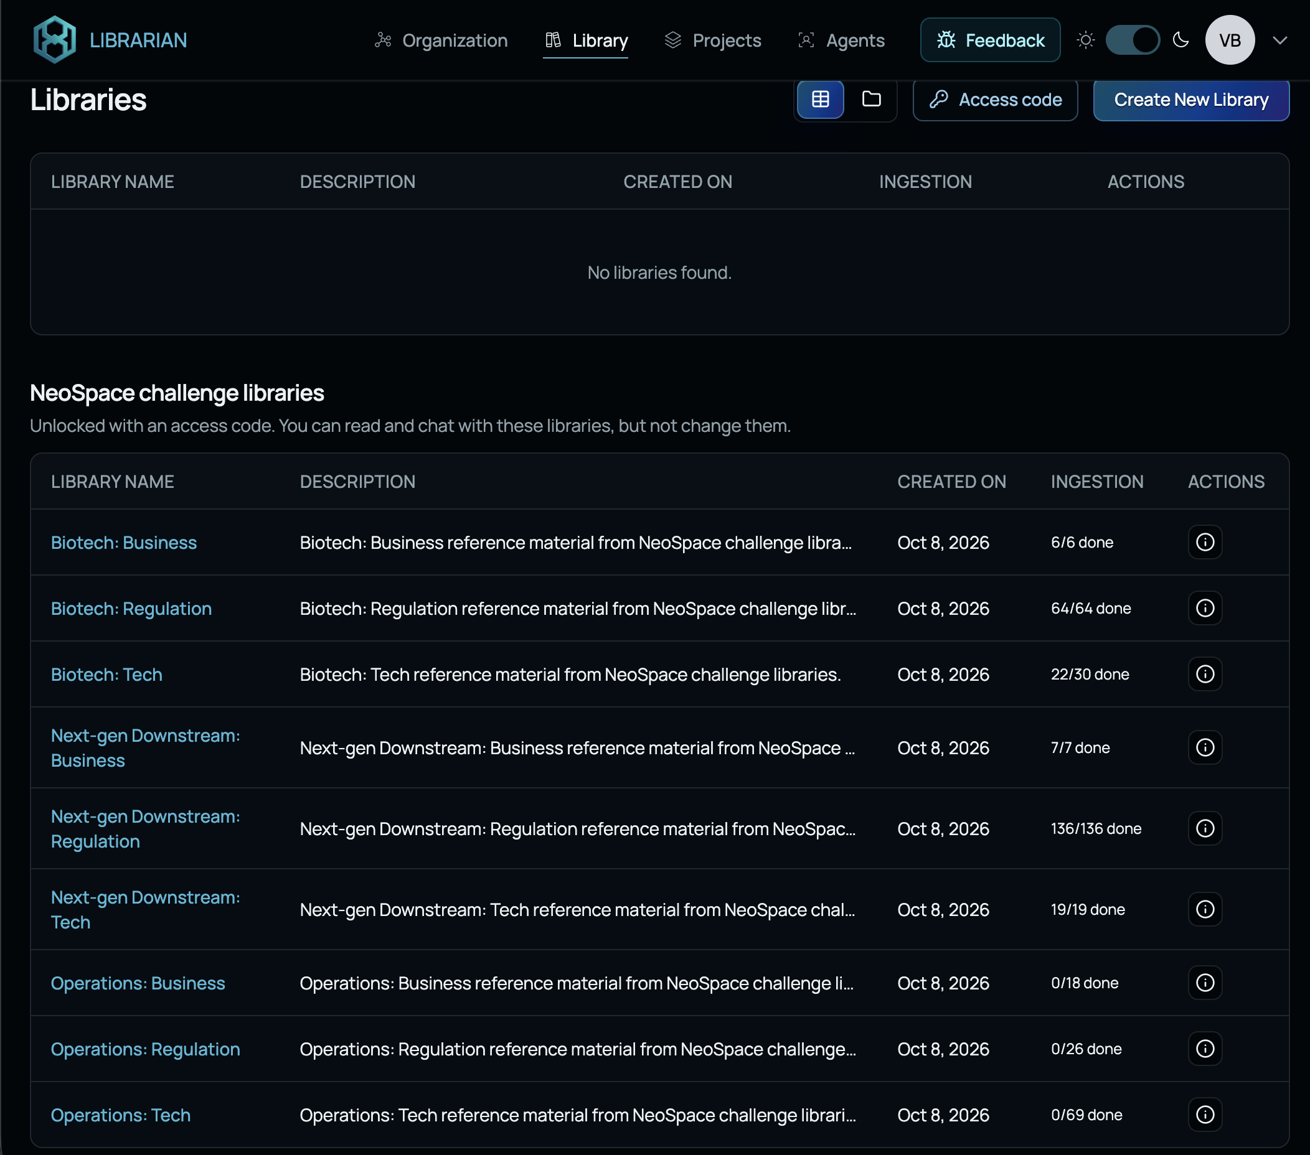
Hackathon Libraries
Provided by partner Companies
Three libraries per challenge area
  Biotech : Business
  Biotech : Regulation
  Biotech : Tech
  …..
Initial starting-point knowledge pool
You can make your own libraries as
your research grows
Notes:
Existing challenge Libraries provide a starting point for research. Review what material is available and how it relates to the questions your team needs to answer. Additional documents can help fill specific gaps. The interface handles library selection, allowing prompts to focus on the research question.

Slide 14
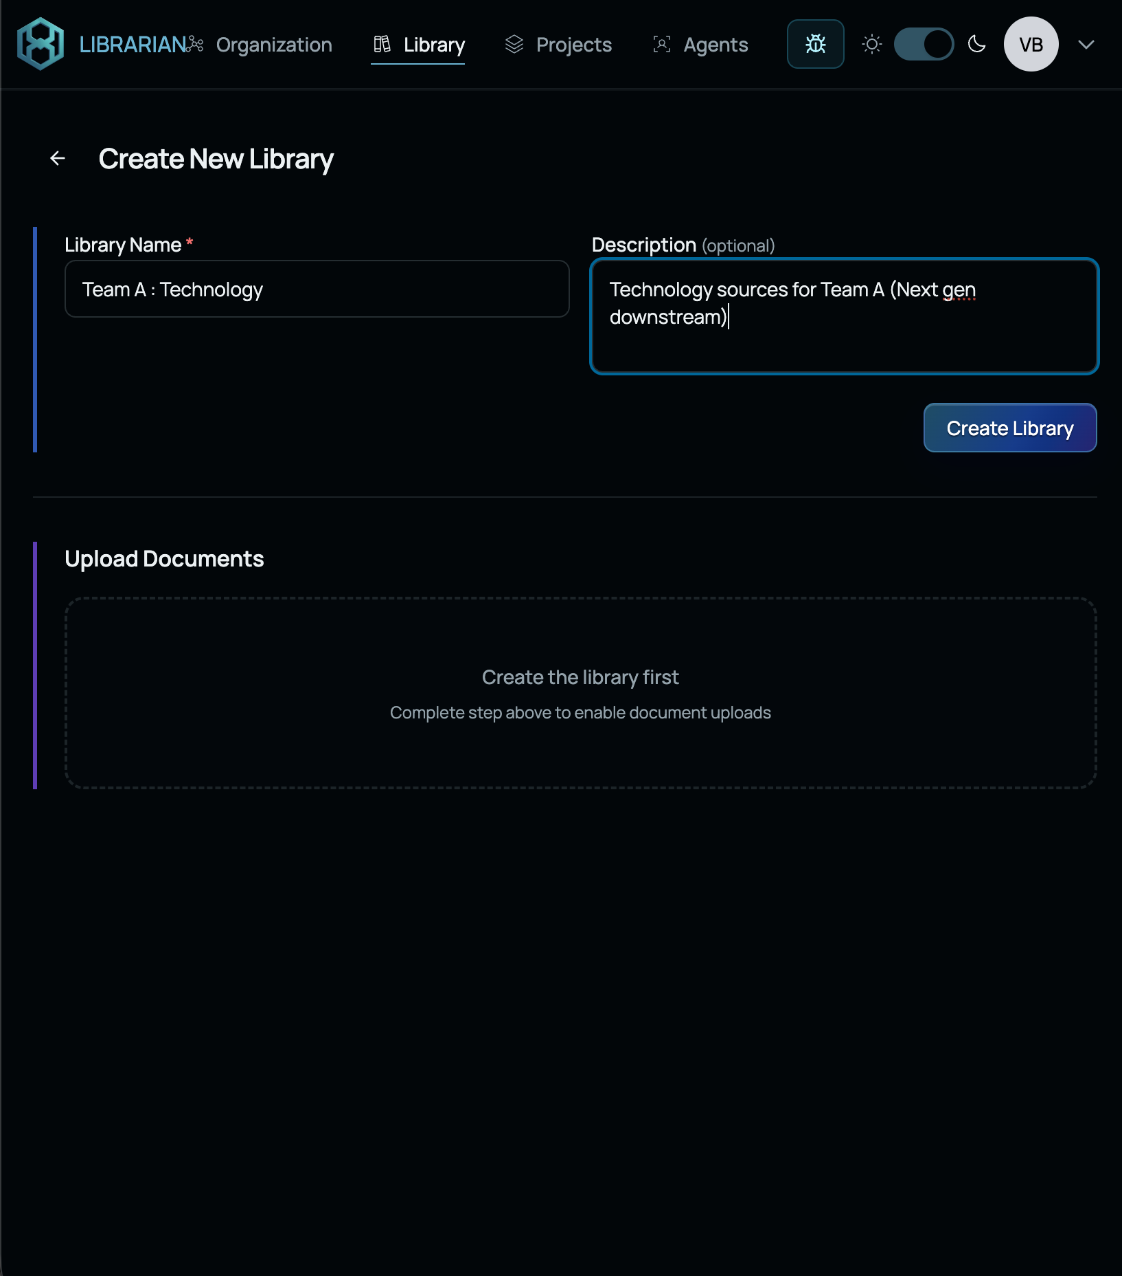
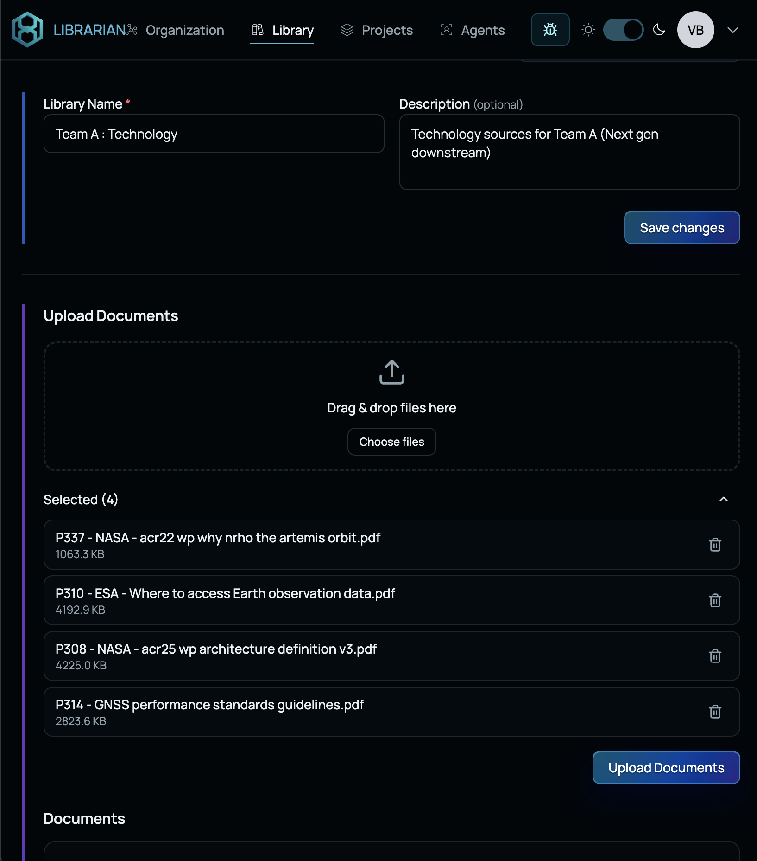
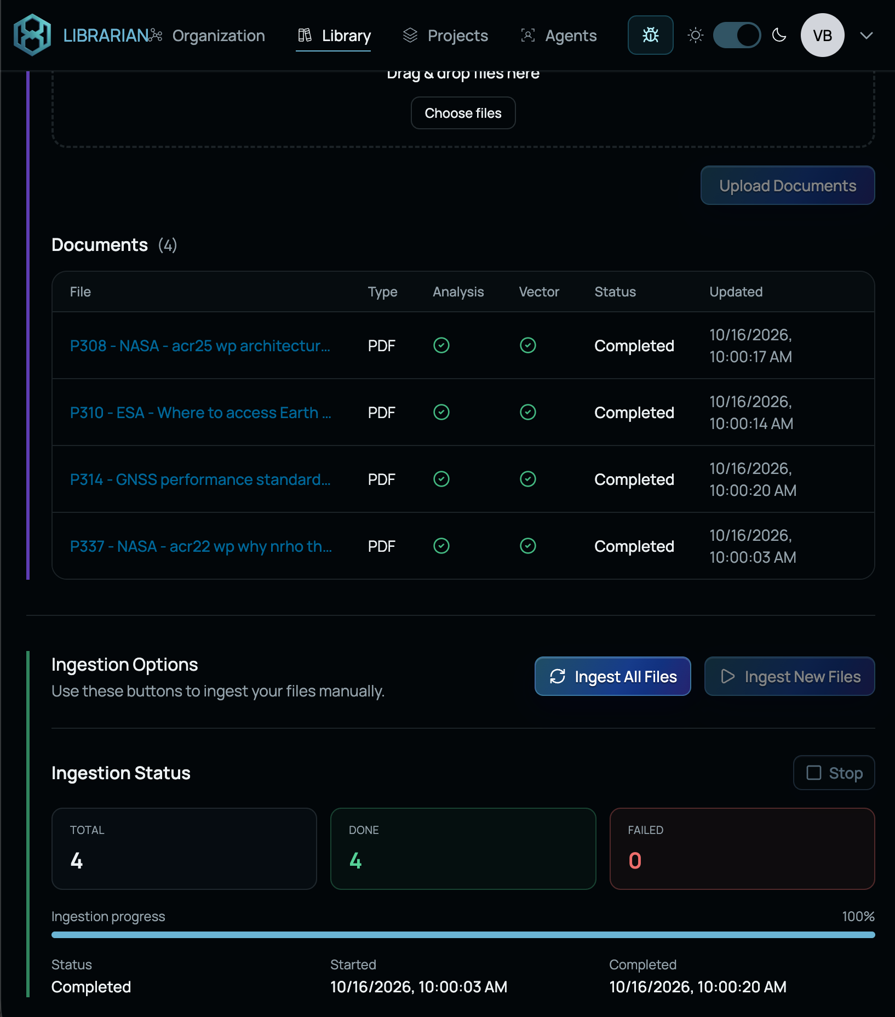
Create your own Libraries
Create Library → Upload source → Ingest

Slide 15




SPAIDER PLATFORM
Knowledge Agent
Research and concept development in Sessions 1 and 2
Ask a focused question
Compare and test ideas
Examine evidence and assumptions
Use arXiv or Web search
Discuss findings with a teammate.
10
Notes:
Use the Knowledge Agent to investigate focused questions about the concept, architecture, requirements or market. Give it the scenario, the decision you need to make and the constraints that matter. Ask follow-up questions when the answer is too broad or leaves an assumption unexplained. Existing Libraries and additional research through arXiv or Web search can help fill information gaps. Work through answers with a teammate and agree what they mean for your design. The agent supports the team's reasoning and does not make the final decision.

Slide 16
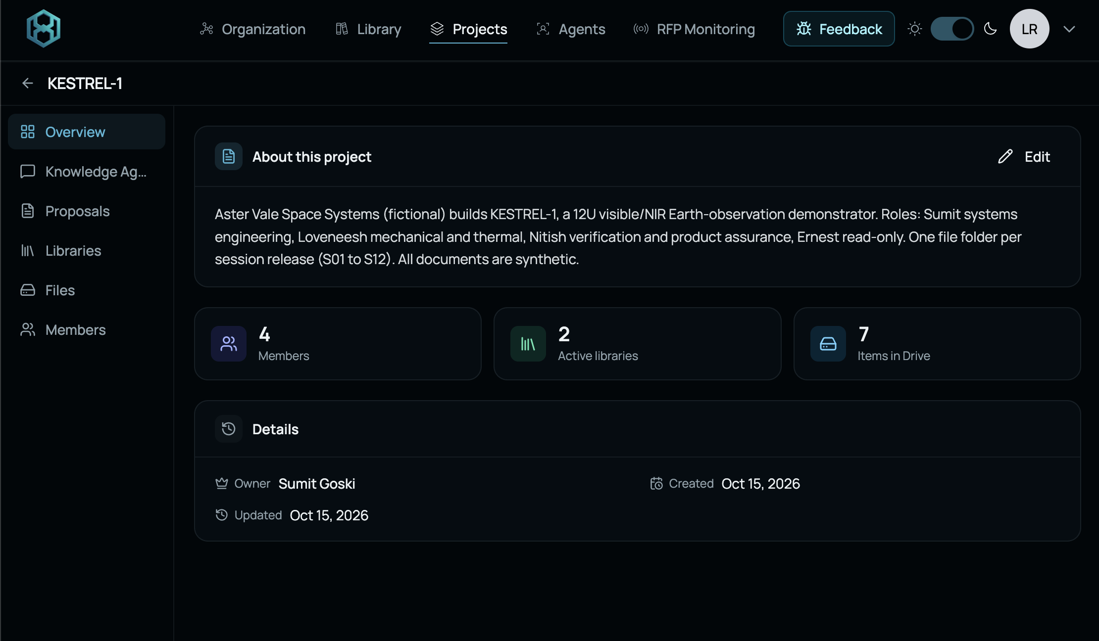




SPAIDER PLATFORM
Projects
One shared workspace for the whole team
Create one shared Project
Add teammates and Libraries
Review each other’s research
Organise inputs, notes and outputs
New project / Libraries / Members / Files
11
Notes:
Use one shared Project to organise the team's challenge work. Add teammates so they can access and review the work, and confirm that everyone can find the relevant conversations, files and agreed outputs. Keep working notes and checkpoint summaries organised around the same solution. Teams can split research responsibilities, but should bring important findings and decisions back together. A shared workspace helps expose contradictions between technical choices, regulatory constraints and the business model before they enter the proposal.

Slide 17
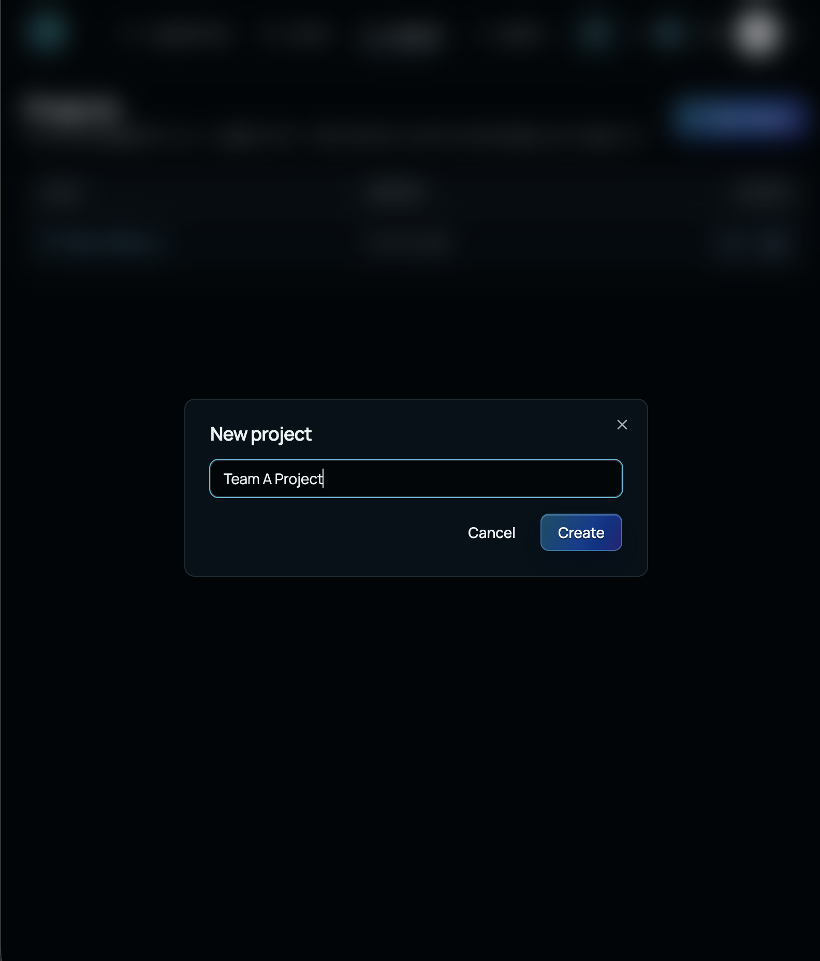
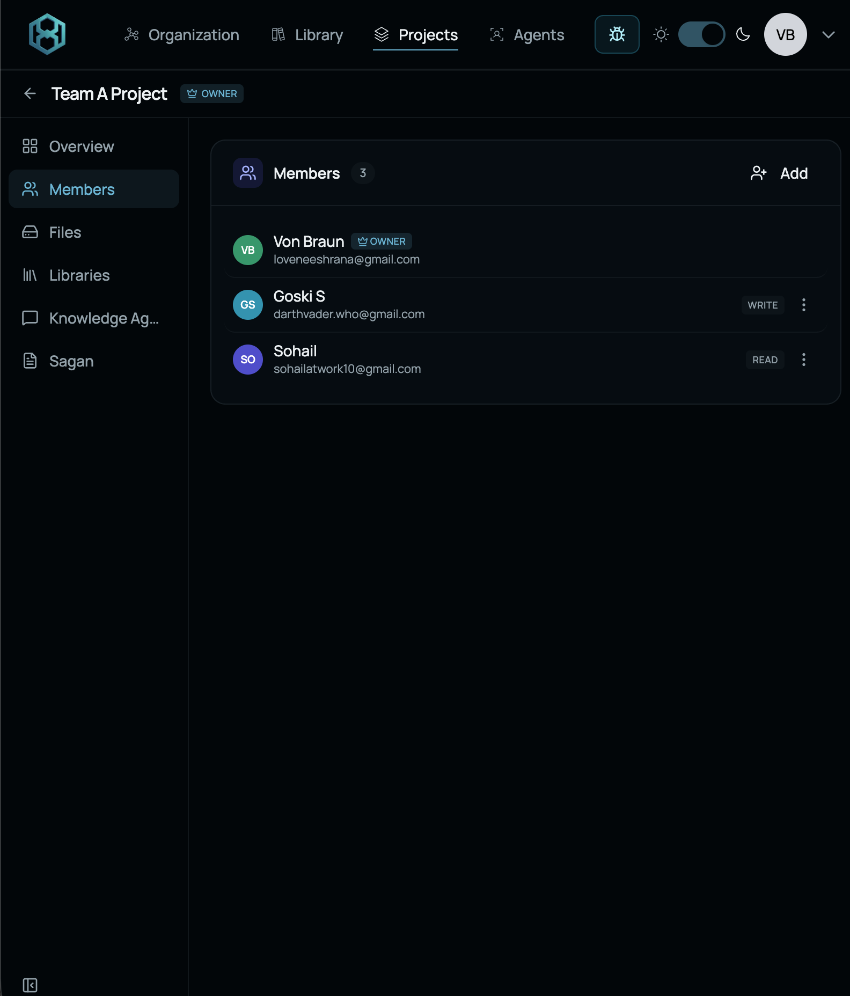
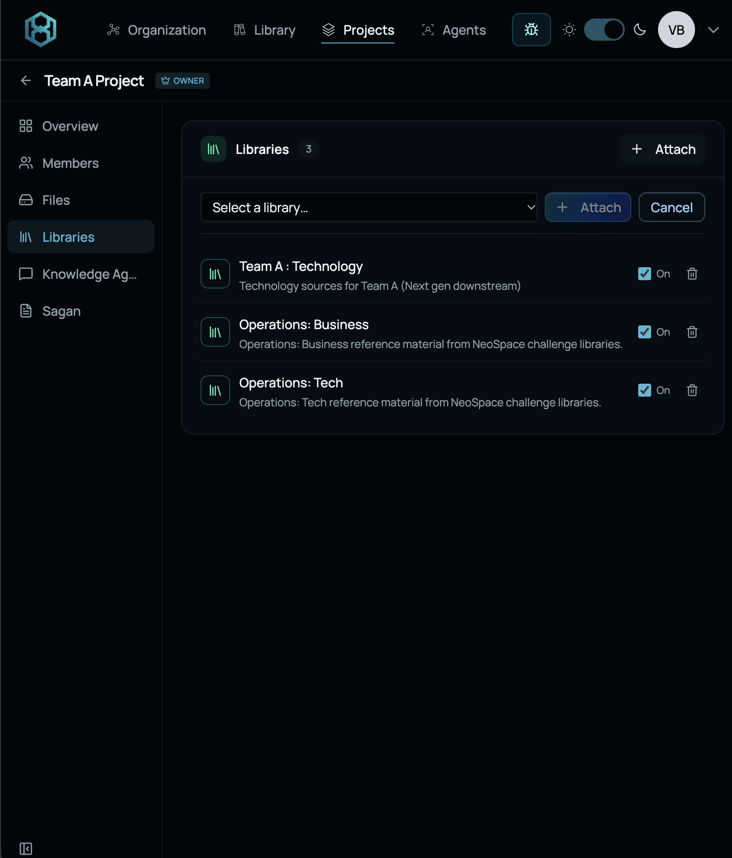
Getting started with Projects
Create Project → Invite Teammates (Read or Write) → Add Libraries (to query and work from)
Notes:
Create a shared Project for the challenge and add teammates. Confirm that everyone can access the relevant work and find the shared files and conversations. Agree how to organise research and record decisions. Bring findings from separate investigations back into the common working record before each checkpoint.

Slide 18
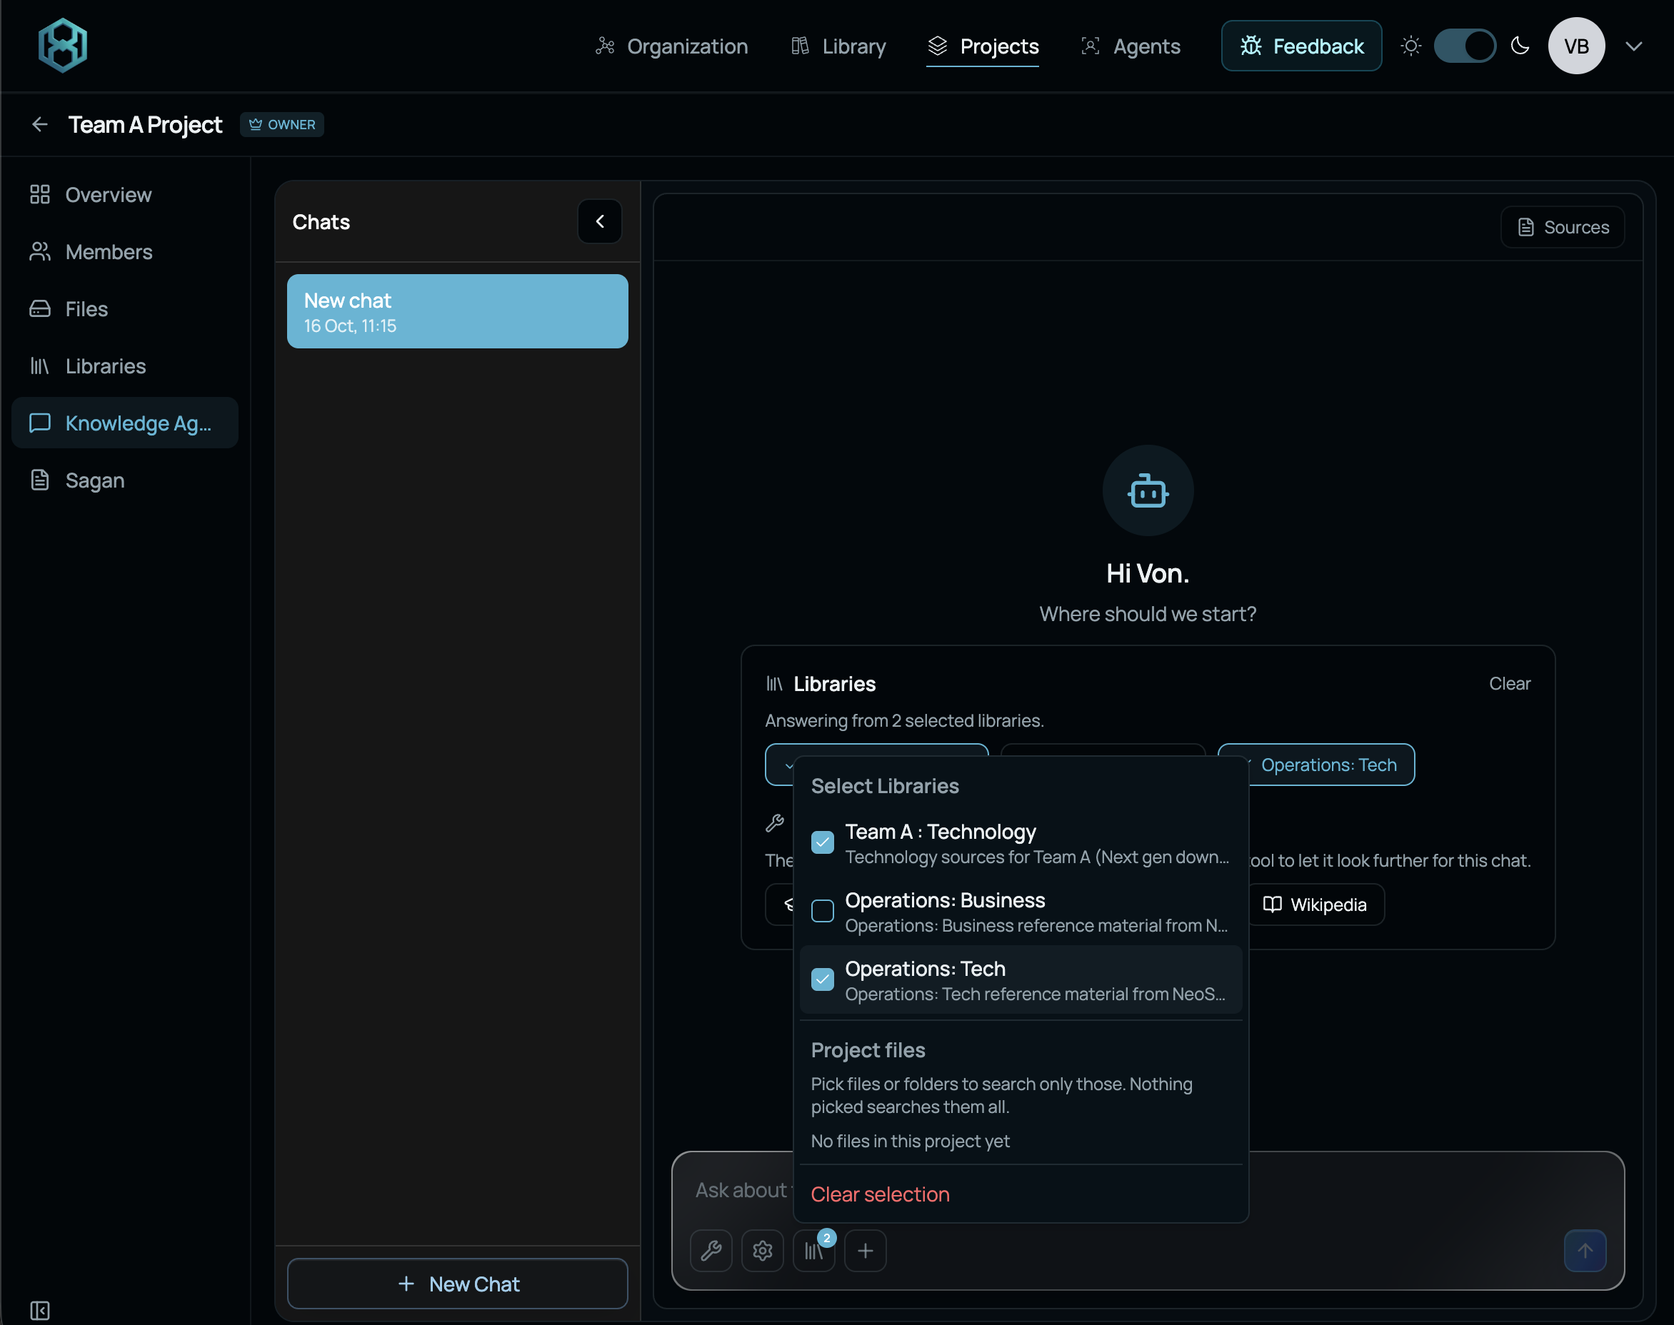
Collaborative Knowledge Work with Projects
Select Libraries
or
Select a web-source
Start the chat
All teammates can join the chat and start working together

Slide 19

Session 1
Concept definition
3 hours. Concept V1, system sketch and initial research
13
Notes:
Develop the initial idea into a concept that the team can explain through operating scenarios and a system sketch. Use early patent and market research to inform the design. Identify initial regulatory constraints and customer value, then prepare questions for the first expert review.

Slide 20







SESSION 1: CONCEPT DEFINITION
Session 1 process
3 hours. Project + Knowledge Agent + Libraries + patent and market search
1A
1B
1C
1D
1E
Project and
problem
Operational
scenario
Patents and
market
System parts
and value
Concept
checkpoint
SESSION OUTPUT
Concept V1 + system sketch + initial evidence
Use the checkpoint questions to prepare for expert feedback.
14
Notes:
Begin with a common understanding of the problem and the intended user. Develop normal and disrupted operating scenarios, then identify the main components and connections. Start patent and market research as soon as the concept is specific enough to compare with existing work. IPIL support and Espacenet can inform that comparison. Keep technology as the main focus while also identifying possible customers and regulatory constraints. By the end, agree Concept V1, a system sketch and the main questions for expert feedback.

Slide 21
SESSION 1: CONCEPT DEFINITION
Session 1 deliverables
Questions for the expert checkpoint
Q1
Who uses the solution, and what problem does it solve?
Q2
What are the main parts, and how do they connect?
Q3
How does it work normally and when something goes wrong?
Q4
Which rules and standards may apply?
Q5
Which existing offers address a similar need, and who buys them?
DELIVERABLES
Concept V1 + system sketch + evidence + checkpoint summary
15
Notes:
Prepare a short checkpoint summary that answers the five questions on this slide. Show the problem, main components and operating scenarios using a sketch where useful. Explain what the initial research changed in your thinking, including relevant existing offers or prior art. Identify likely regulatory questions and the customer or buyer you currently have in mind. Distinguish agreed choices from assumptions. Ask experts about the decisions that would most affect the next version of the concept, then record the feedback and next actions.

Slide 22

Session 2
Integrated solution
3 hours. Solution V2, business model and regulatory approach
16
Notes:
Use the first review to refine the technical solution and investigate the requirements that affect it. Develop a working business model by the sixth working hour. Bring the three workstreams together in Solution V2 and prepare the second expert checkpoint.

Slide 23




SESSION 2: INTEGRATED SOLUTION
Session 2 process
3 hours. Knowledge Agent + Libraries + expert feedback
2A
2B
2C
2D
2E
Feedback
actions
Product and
architecture
Requirements
and IP
Business and
feasibility
Solution
checkpoint
SESSION OUTPUT
Hour 6: Solution V2 + business model + regulatory issues
Use the checkpoint questions to prepare for expert feedback.
17
Notes:
Start by deciding how to respond to the first expert review. Refine the product features, interfaces, deployment and failure handling. Investigate the requirements that could change design or operations and relate patent findings to the proposed solution. Develop the business model alongside these choices, including the buyer, value, revenue logic, main costs and delivery needs. By the sixth working hour, the team should have an integrated Solution V2, a working business model and a clearer regulatory approach. Record unresolved issues for the next review.

Slide 24
SESSION 2: INTEGRATED SOLUTION
Session 2 deliverables
Questions for the expert
Q1
How did feedback change the solution and its design?
Q2
Which requirements affect the design and operations?
Q3
How will you address them, and what remains uncertain?
Q4
Who will buy it, why, and how will the business work?
Q5
What costs, partners and feasibility tests are needed?
DELIVERABLES
Solution V2 + business model + regulatory approach + summary
18
Notes:
The second checkpoint should explain how the solution improved after feedback and why the current design is credible. Connect requirements to specific design or operating choices. Explain the business model in enough detail to identify who pays, what they receive and what it takes to deliver the offer. Highlight important cost assumptions, partner needs and feasibility tests. Experts should be able to see where technology, regulation and business support one another and where uncertainty remains. Record the changes and investigations needed in Session 3.

Slide 25

Session 3
Proposal and execution plan
3 hours. Refined solution, proposal, R&D plan and budget
19
Notes:
Use Sagan to develop the proposal from the agreed work. Continue to refine technology, regulation and business as gaps emerge during writing. Define the R&D activities, milestones and use of funds. Review the proposal and pitch together and incorporate final expert feedback.

Slide 26





SESSION 3: PROPOSAL AND EXECUTION PLAN
Session 3 process
Sagan + agreed evidence. Refine all three workstreams while drafting.
3A
3B
3C
3D
3E
Grounding
Solution
refinement
Artifacts
Drafting
Finalization
SESSION OUTPUT
Refined solution + 10–15-page proposal + pitch
Use the checkpoint questions to prepare for expert feedback.
22
Notes:
Use the second expert review to update the solution before drafting. Ground the proposal in the agreed work, refine remaining choices and identify capability gaps. Build the R&D plan and budget, then draft and assemble the three proposal sections. Writing can reveal contradictions or missing evidence, so continue to refine technology, regulation and business throughout the session. Finish with a consistency review and prepare pitch material from the same agreed solution. The final expert review can still lead to revisions before submission.

Slide 27

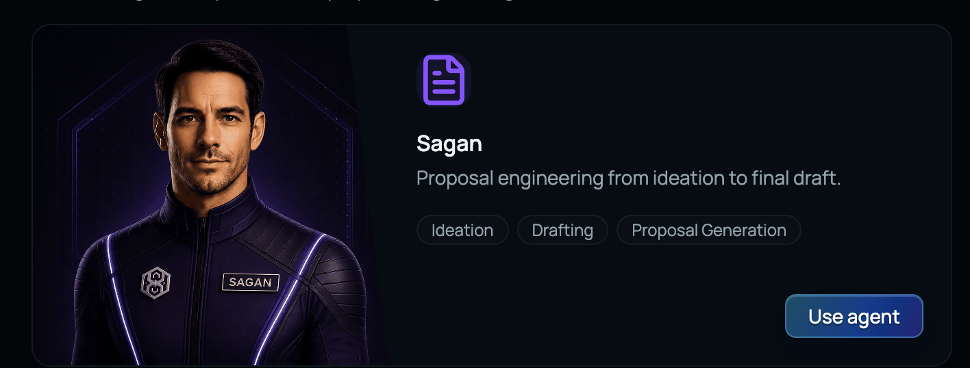

SESSION 3: PROPOSAL AND EXECUTION PLAN
Sagan
Proposal engineering in Session 3
Ground the proposal
Confirm solution and team
Plan work, schedule and funds
Draft and assemble sections
Output: 10–15-page proposal + pitch
20
Notes:
Sagan supports proposal development using the work the team has already agreed. Ground the document in the concept, expert feedback and the proposal structure. Refine unresolved technical, business or regulatory points before and during drafting. Develop the work plan, schedule and funding needs, then assemble the sections into a consistent document. Review every generated section as a team. Check that the proposed activities and budget match the solution you intend to build and that assumptions remain visible.

Slide 28
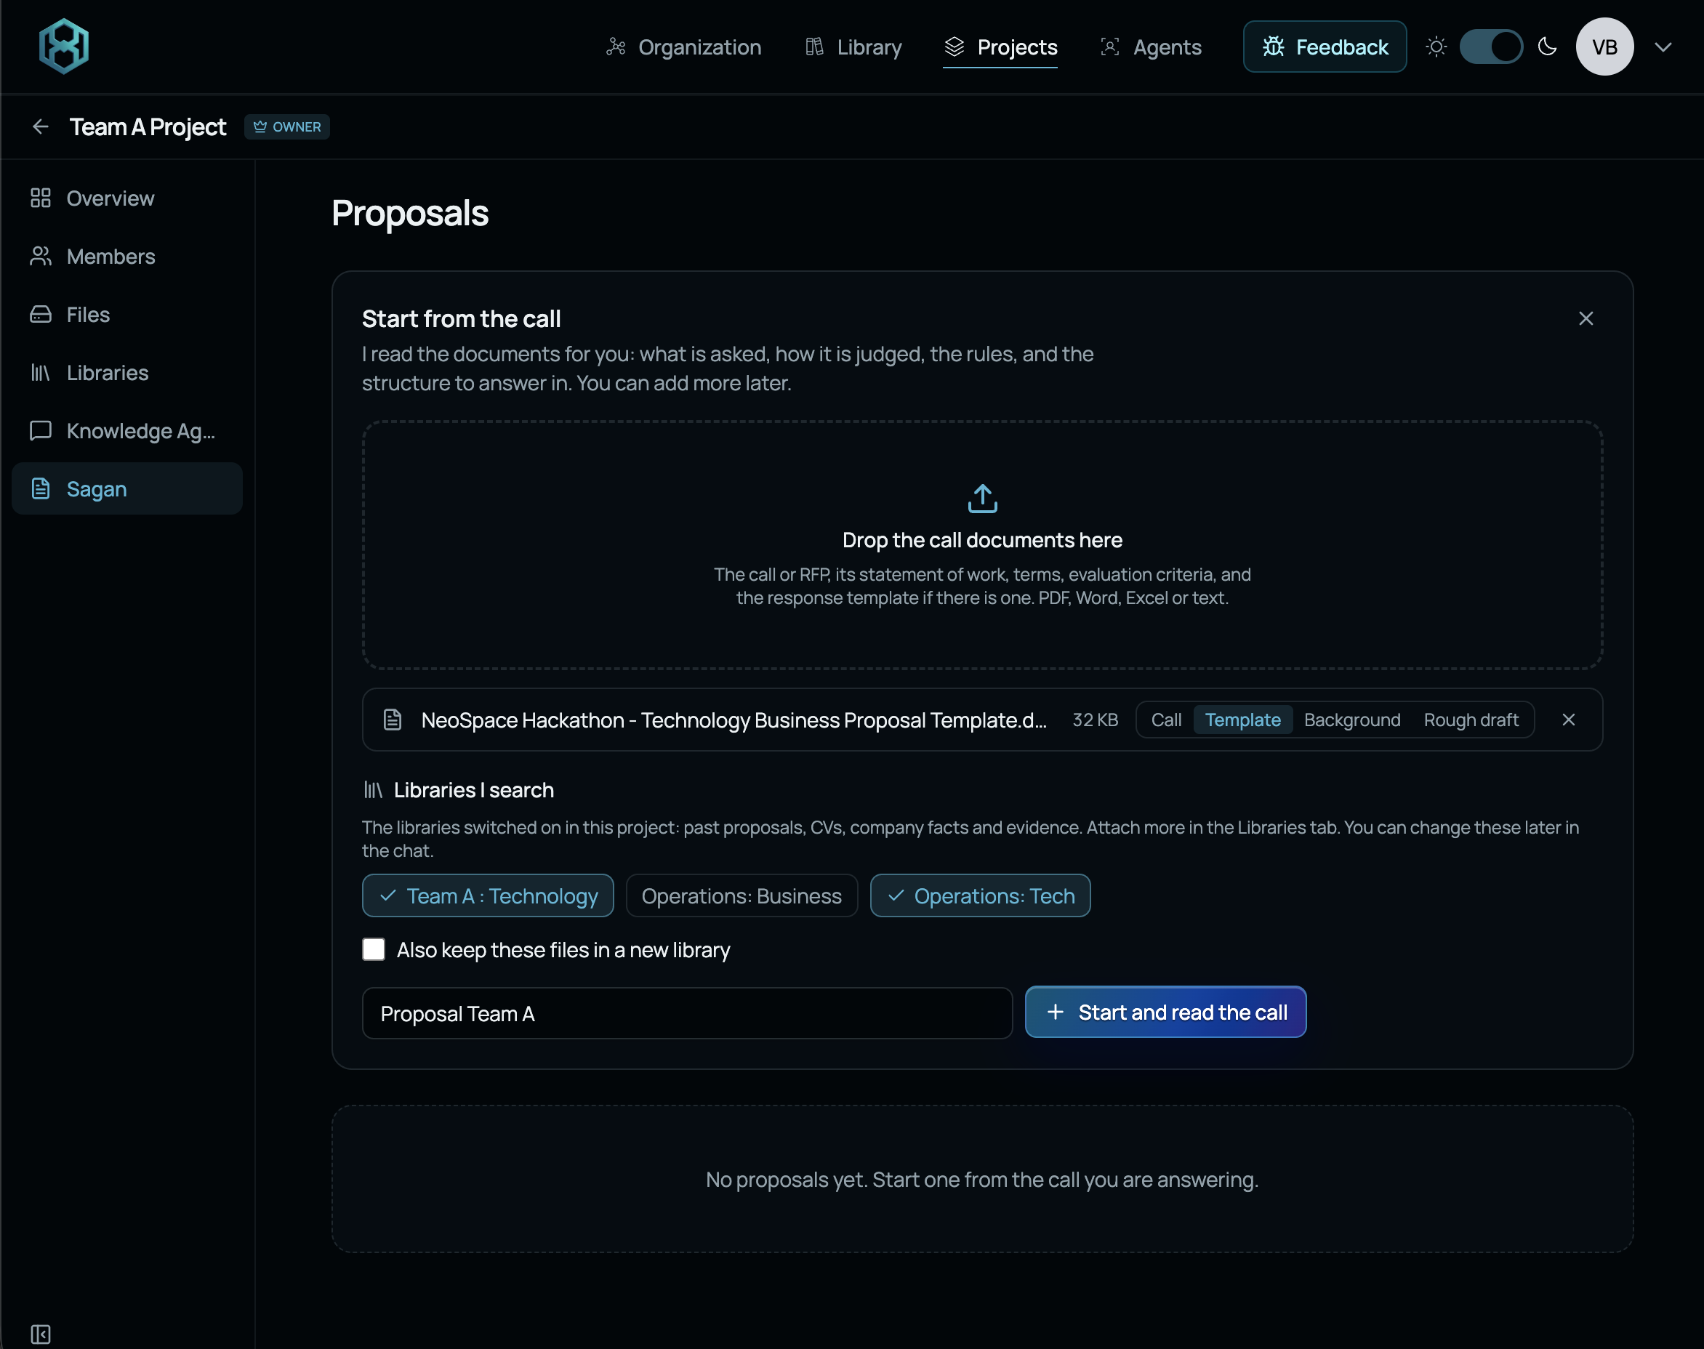
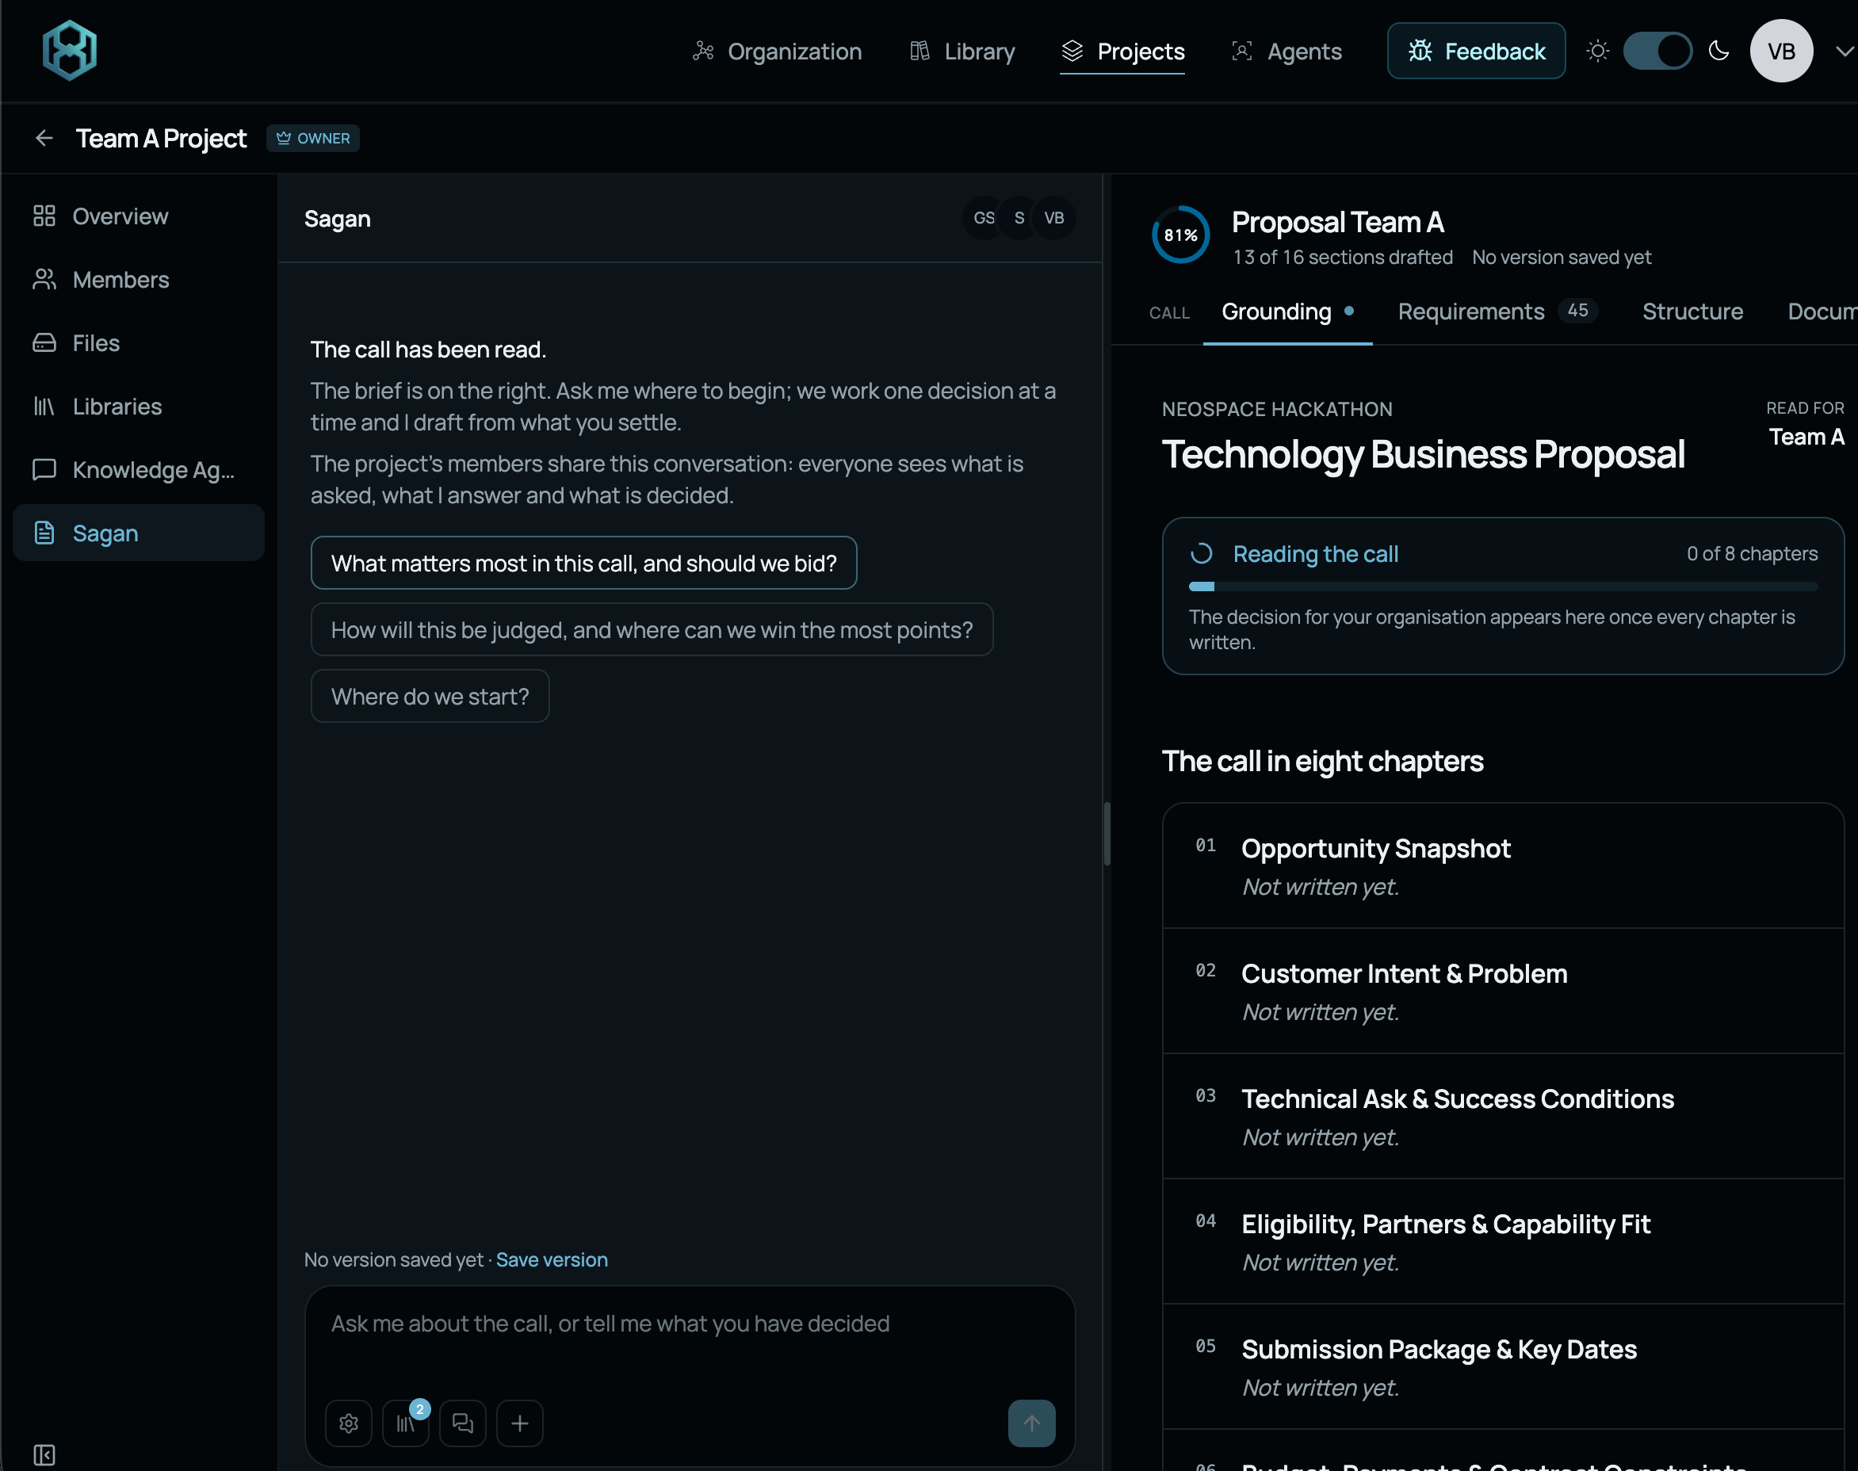
Getting started with Sagan
Select existing libraries
Start drafting proposal with your teammates and Sagan
Notes:
Bring the agreed solution, proposal template and expert feedback into the proposal-development work. Use Sagan to organise the structure, refine the solution, plan implementation and draft sections. The team reviews the content at every stage and resolves gaps as they emerge. Keep the document consistent with the architecture, business model and funding plan.

Slide 29
SESSION 3: PROPOSAL AND EXECUTION PLAN
Session 3 deliverables
Questions for the expert checkpoint
Q1
What changed across technology, regulation and business?
Q2
How will you reach customers, deliver the offer and earn revenue?
Q3
What R&D steps, milestones and partners will deliver the solution?
Q4
What funds are needed, and how will you use them?
Q5
What evidence, risks and next steps support the proposal?
DELIVERABLES
10–15-page proposal + pitch draft + feedback actions
23
Notes:
The third checkpoint tests whether the proposal describes one coherent solution and a credible route to implementation. Explain the refinements across all three workstreams, the customer offer and revenue logic, and the work needed to develop the solution. Show how milestones, partner roles and requested funds connect to that work. Identify remaining risks and immediate next steps. Bring a proposal draft and pitch material so experts can give actionable feedback. Record the changes required before the final submission.

Slide 30

Proposal and delivery
Proposal contents, expert feedback and final outputs
24
Notes:
The final document has three main sections within a 10–15-page limit. It describes the solution, its business model and the plan to develop it. Use expert feedback to improve both the proposal and pitch before submission.

Slide 31
PROPOSAL AND DELIVERY
Proposal contents
Suggested allocation: 10–15 pages.
Technology
Business Model
Implementation Plan
5 pages
3 pages
4 pages
Concept, problem and users
Market, customers and alternatives
R&D work, milestones and validation
Operating scenarios and scope
Resources, budget and use of funds
Value proposition, offer and revenue
Technical architecture
Team, partners and delivery risks
Feasibility, maturity and prior art
Economics, costs and assumptions
Next steps, feedback and references
Regulation and standards
25
Notes:
Use three main sections for the complete Technology Business Proposal. A suggested allocation is five pages for Technology, three for Business Model and four for Implementation Plan. Keep the full document within 10–15 pages, including figures, references and project details. Technology explains the problem, operating scenarios, architecture, feasibility, maturity, prior art and regulatory approach. Business Model explains the market, customer value, offer, revenue, costs and assumptions. Implementation Plan explains the R&D work, milestones, validation, resources, budget, use of funds, team, partners, risks and next steps. Adjust the allocation to the solution while keeping all these topics covered.

Slide 32


EXPERT FEEDBACK
Expert feedback and revision
Use the checkpoint questions after each working session
Share the checkpoint summary
Ask for feedback on open decisions
Record changes and next actions
Expert comment
Team response
Owner and next action
Record feedback in the Project. Agree changes and next actions.
26
Notes:
After every working session, share the checkpoint summary and the most important open decisions with experts. Record each material comment, the team's response and an owner for the next action. A comment may require a design change, further research or a clearer explanation. Consider its effects on technology, regulation and business together. Update the common working document before the next checkpoint or proposal draft. Keep enough of the reasoning to explain why the solution changed and which questions remain open.

Slide 33


DELIVERY
Final proposal and pitch
One agreed solution, two outputs
Proposal
Pitch
10–15 pages
5-minute pitch + 5-minute Q&A
Technical and regulatory approach
Select the strongest evidence
Business model and R&D plan
Explain the solution and its value
Budget, evidence and next steps
Show the plan and funding needs
Review both outputs together before submission.
27
Notes:
The proposal and pitch describe the same agreed solution. Keep the proposal within 10–15 pages, including figures, references and project details. Use its strongest material to explain the problem, proposed solution, business case and implementation needs in the pitch. The discussed pitch format is five minutes of presentation followed by five minutes of questions. Follow the confirmed event timetable for final submission and other presentations. The OSIP-compatible structure provides a useful reference format. The hackathon does not require submission to ESA or imply an ESA follow-up.

Slide 34
Next Steps
Allocate one team leader / representative
Signup on SPAIDER Space Platform
https://neospace.spaiderspace.com
Once approved, invite teammate, get started
Supporting Resources
  User guide SPAIDER Space
  Contact SPAIDER Team: info@spaiderspace.com

Slide 35
THANK YOU
SPAIDER Space S.a.r.l.
www.spaiderspace.com
for further questions and doubts:
  loveneesh.rana@spaiderspace.com
  info@spaiderspace.com
3
Notes:
The challenge develops one solution through three sessions. Understand the expected outputs and how team discussion, agents and expert feedback support the work. Technology, regulation and business stay connected throughout.

Slide 36

Appendix
Detailed reference
Session steps, examples and prompt guide
A1
Notes:
This reference section expands the steps in the three working sessions. It includes the Mission Memory example, the progression of the three workstreams and prompts that can help start or refine a conversation. Use the relevant step when the team needs more structure. The examples are adaptable guides. Discuss answers together, agree the decisions that matter and keep the shared Project up to date.

Slide 37

APPENDIX: SESSION 1: CONCEPT DEFINITION
Shared project and problem definition
Step 1A. Knowledge Agent + shared Project
Set up the shared Project
OUTPUT
Agree the user and problem
Problem statement
Assumptions
Record assumptions
EXAMPLE PROMPT
"From [brief] and [concept], identify the users, problem and assumptions."
A2
Notes:
Agree the user, the problem and the scope before developing detailed architecture. Use the challenge brief and initial concept to identify what the solution needs to achieve. Separate facts from assumptions and record the questions that could change the concept. Set up the shared Project so the whole team can review the working record. The output of this step is a concise problem statement and an initial assumptions list. The example prompt can help structure the discussion, but the team should agree the wording and priorities.

Slide 38


APPENDIX: SESSION 1: CONCEPT DEFINITION
Operating scenarios and solution scope
Step 1B. Knowledge Agent + team discussion
Describe normal and disrupted use
OUTPUT
Identify actors and operating states
ConOps
System sketch
Show what is inside and outside the solution
EXAMPLE PROMPT
"Describe normal and disrupted use of [concept]. Identify actors, system actions and states."
ConOps: Concept of Operations
A3
Notes:
A Concept of Operations, or ConOps, explains how people and the system interact in use. Describe a normal scenario and a disrupted scenario. Identify the actors, their actions, the system's responses and the states it moves through. Make clear what sits inside the solution and what depends on external services or organisations. Use these scenarios to test whether the concept is understandable and complete enough to sketch. Keep the description concrete enough to identify components, interfaces and human decisions.

Slide 39


APPENDIX: SESSION 1: CONCEPT DEFINITION
Existing solutions and market landscape
Step 1C. Knowledge Agent + patents + company research
Start patent and market research early
OUTPUT
Compare patents, products and companies
Evidence comparison
Design choices
Identify alternatives and potential partners
EXAMPLE PROMPT
"Compare [concept] with relevant patents, products and companies. Identify alternatives and potential partners."
IPIL / Espacenet / company sources / startup databases
A4
Notes:
Begin patent and market research early enough to influence the concept. Use IPIL support and Espacenet to investigate related patents, and examine products, companies and other approaches that address the same need. Compare their functions and limitations with your intended solution. Identify possible partners and capabilities you may need. Prior art can change the design or narrow the claim of novelty. Treat the search as an initial landscape review and record questions that need further specialist investigation.

Slide 40


APPENDIX: SESSION 1: CONCEPT DEFINITION
Main system parts and value proposition
Step 1D. Knowledge Agent + selected Libraries
Define components and connections
OUTPUT
Specify data, deployment and authority
Initial architecture
Value and constraints
Link design to value and constraints
EXAMPLE PROMPT
"For [scenario], define components, data flows, deployment and human authority. Flag constraints."
Discuss together or divide roles.
A5
Notes:
Turn the operating scenarios into an initial architecture. Identify each main component, the information it receives and produces, and how it connects to other parts. Explain where software or agents would run and what requires human approval. For an AI-based concept, distinguish the agent's role from the model and memory services it uses. Relate these design choices to user value, operational limits and initial regulatory constraints. Discuss together or assign research roles, then agree one system sketch.

Slide 41


APPENDIX: SESSION 1: CONCEPT DEFINITION
Concept checkpoint and review questions
Step 1E. Shared Project + Knowledge Agent
Agree the current concept
OUTPUT
Record findings and decisions
Concept V1
Checkpoint summary
Prepare expert questions
EXAMPLE PROMPT
"Summarise our agreed concept, decisions and open questions for expert feedback."
A6
Notes:
Consolidate the team's agreed concept before the first expert review. Combine the problem statement, operating scenarios, architecture sketch and initial research into a short common summary. Highlight the decisions already made and the assumptions that still need testing. Check that the team describes the same solution across all workstreams. Prepare specific questions where expert advice could change the design or direction. Keep the summary in the shared Project so the next session begins with a clear record.

Slide 42

APPENDIX: SESSION 2: INTEGRATED SOLUTION
Expert feedback and design changes
Step 2A. Shared Project + Knowledge Agent
Discuss expert feedback
OUTPUT
Agree changes and investigations
Feedback actions
Updated concept
Assign owners and next actions
EXAMPLE PROMPT
"Turn [feedback] into changes or investigations. Explain effects on technology, regulation and business."
A7
Notes:
Review expert feedback together and decide what action each comment requires. Some comments will change the solution directly, while others will lead to research or a test. Assign an owner and describe the result needed to close each action. Consider whether a change in one area affects another, such as a deployment choice that changes regulatory obligations or cost. Update the concept and the common record before developing further detail.

Slide 43


APPENDIX: SESSION 2: INTEGRATED SOLUTION
Product features and detailed architecture
Step 2B. Knowledge Agent + Technology Library
Define core features and requirements
OUTPUT
Specify interfaces and deployment
Architecture
Requirements
Describe failure handling
EXAMPLE PROMPT
"Detail [architecture]: features, interfaces, deployment and failure handling. Link functions to requirements."
A8
Notes:
Refine the initial sketch into an architecture with defined functions and interfaces. Explain the core product features and the requirements they satisfy. Specify deployment, information flows, dependencies and authority over important actions. Describe what happens when a component fails or a service is unavailable. Use concrete operating scenarios to check the design. The result should let another reader understand how the parts work together and what still needs validation.

Slide 44


APPENDIX: SESSION 2: INTEGRATED SOLUTION
Regulatory requirements and IP positioning
Step 2C. Knowledge Agent + Regulation Library + patent findings
Identify relevant requirements
OUTPUT
Map requirements to design choices
Requirements map
IP positioning
Compare relevant patents
EXAMPLE PROMPT
"Map relevant requirements to [activity/location]. Compare patents and identify design implications."
A9
Notes:
Relate regulatory and standards questions to the actual activity, operating location and organisations involved. Map relevant requirements to design or operational choices, then identify gaps and questions for experts. Revisit patent findings as the solution becomes more specific and explain how they affect differentiation or implementation. Separate established requirements from interpretations that still need confirmation. The output is a requirements map and an initial position on prior art and IP, with clear implications for the design.

Slide 45


APPENDIX: SESSION 2: INTEGRATED SOLUTION
Business model and feasibility evidence
Step 2D. Knowledge Agent + Business and Technology Libraries
Define buyer, value and delivery
OUTPUT
Identify costs and resource needs
Business model
Validation plan
Test the key assumption
EXAMPLE PROMPT
"Assess [business model]: buyer value, costs and delivery. Suggest a test for the key assumption."
A10
Notes:
Define who buys the solution, who uses it and what value each receives. Explain the offer, delivery model and revenue logic. Identify the main costs, resources and external capabilities required. State the assumptions behind estimates and select a practical test for the assumption most likely to change the business case. Check that technical performance and the regulatory approach support what you intend to sell. Record a working business model and the next validation needs.

Slide 46


APPENDIX: SESSION 2: INTEGRATED SOLUTION
Integrated design checkpoint
Step 2E. Shared Project + Knowledge Agent
Check all three dimensions together
OUTPUT
Update the shared working document
Solution V2
Review material
Present changes and open questions
EXAMPLE PROMPT
"Combine our findings into Solution V2. Flag inconsistencies, evidence gaps and expert questions."
A11
Notes:
Bring the technical architecture, regulatory approach and business model into one version of the solution. Look for inconsistencies in scope, performance, customer expectations, costs and responsibilities. Resolve what you can and make remaining gaps explicit. Update the shared document and prepare the second checkpoint summary. Explain what changed after the first review and which decisions now need expert input. This integrated Solution V2 becomes the starting material for proposal development.

Slide 47


APPENDIX: SESSION 3: PROPOSAL AND EXECUTION PLAN
Proposal grounding and feedback integration
Step 3A. Sagan: Grounding
Incorporate the second review
OUTPUT
Extract the proposal structure
Document map
Evidence gaps
Assign evidence to each section
EXAMPLE PROMPT
"Use [proposal template] to organise our agreed solution. Identify gaps and actions from feedback."
A12
Notes:
Use the second expert review and the proposal template to organise the agreed work. Map existing material into Technology, Business Model and Implementation Plan. Identify missing evidence, unresolved decisions and follow-up actions. Keep the proposal grounded in what the team actually intends to deliver. Sagan can help organise the document, but the team should confirm the structure and the facts before developing full sections.

Slide 48


APPENDIX: SESSION 3: PROPOSAL AND EXECUTION PLAN
Solution refinement and team capabilities
Step 3B. Sagan: Proposal Ideation
Refine technical and commercial choices
OUTPUT
Resolve business and regulatory questions
Refined solution
Partner needs
Identify capability and partner gaps
EXAMPLE PROMPT
"Refine [Solution V2] using [feedback]. Resolve technical, business and regulatory gaps. Identify partner needs."
A13
Notes:
Continue to refine the solution while the proposal takes shape. Resolve open technical, commercial and regulatory questions and make the chosen approach consistent across sections. Check whether the team has the capabilities to carry out the plan. Identify what must come from partners, suppliers or external facilities. Explain the effect of these dependencies on delivery, cost and risk. Keep unresolved points visible and assign the next action needed to address them.

Slide 49

APPENDIX: SESSION 3: PROPOSAL AND EXECUTION PLAN
R&D plan and use of funds
Step 3C. Sagan: Artifacts
Define work packages and milestones
OUTPUT
Plan resources and validation
Work plan
Budget
Explain the budget and use of funds
EXAMPLE PROMPT
"Plan work packages, milestones and tests for [target TRL]. Explain the budget and use of funds."
Current and target TRL + validation criteria
A14
Notes:
Define the R&D activities needed to move from the current maturity to the intended next stage. Use work packages with clear outputs, milestones and validation criteria. Explain the current and target TRL where relevant and connect progress to evidence from planned tests. Estimate the people, facilities and other resources required. Build a budget that follows the work and explains how the requested funds will be used. State the basis of estimates and any important dependencies.

Slide 50


APPENDIX: SESSION 3: PROPOSAL AND EXECUTION PLAN
Proposal drafting
Step 3D. Sagan: Drafting
Draft and resolve evidence gaps
OUTPUT
Cover all three dimensions
10–15-page draft
Sources retained
Include delivery, costs and risks
EXAMPLE PROMPT
"Draft [section] using our agreed solution and [template]. Flag gaps and inconsistencies."
A15
Notes:
Draft the three main proposal sections using the agreed solution and template. Keep technical descriptions, the business model and the implementation plan consistent with one another. Explain the evidence behind important claims and leave uncertain points explicit. Use diagrams or tables where they communicate more clearly than text. Review generated content together and revise it where the team's reasoning is missing. Keep the complete document within the overall 10–15-page limit.

Slide 51


APPENDIX: SESSION 3: PROPOSAL AND EXECUTION PLAN
Proposal consistency and pitch preparation
Step 3E. Sagan: Finalization + team review
Check claims and budget totals
OUTPUT
Assemble the proposal sections
10–15-page proposal
Pitch material
Prepare the pitch and review questions
EXAMPLE PROMPT
"Check the consistency of the claims, schedule and budget. Assemble the proposal and outline the pitch."
A16
Notes:
Read the assembled proposal as one document. Check that the same scope, terminology and assumptions appear throughout, that milestones match the work and that the budget totals and funding needs agree. Resolve contradictions or identify them as open issues with next actions. Select the strongest material for the pitch and prepare for likely questions. After the final expert review, update both outputs so the document and presentation continue to describe the same solution.

Slide 52
APPENDIX: INTRODUCTION
Progress across the three workstreams
All three begin in Session 1 and develop in every session
Workstream | Session 1 Initial | Session 2 Developed | Session 3 Integrated
Technology | Users and scenarios System sketch | Interfaces and evidence Feasibility | Refined design R&D and validation
Regulation | Relevant rules Open questions | Design implications Compliance approach | Actions and owners Remaining gaps
Business | Existing offers Buyer hypothesis | Value and revenue Costs and delivery | Sales approach Funding and execution
A18
Notes:
All three workstreams begin in Session 1. Technology receives the strongest initial emphasis as the team clarifies the concept and architecture, while regulatory and business questions already constrain the design. Session 2 deepens the regulatory approach and establishes a working business model alongside technical refinement. Session 3 brings all three to the level needed for a proposal and execution plan. The emphasis labels describe relative focus, not a rule to postpone work on any dimension.

Slide 53



APPENDIX: PROMPT GUIDE
Prompt structure
Use these references to guide discussion and research.
01
02
03
Context and
question
Constraints and
assumptions
Requested
output
"For [challenge], answer [question] within [constraints].
Return [format] and flag assumptions."
Ask, check together, then refine.
A19
Notes:
A useful prompt gives enough context to understand the challenge, states the question and defines relevant constraints and the requested output. Replace bracketed fields with details from your team's work. Ask for assumptions to be visible so you can discuss them. SPAIDER provides citations automatically and library selection takes place in the interface, so prompts can concentrate on the question and reasoning. Read the answer together, decide what is useful and ask a more specific follow-up where needed.

Slide 54
APPENDIX: PROMPT GUIDE
Session 1 prompt references
Knowledge Agent: adapt prompts to your concept and questions.
1A
Project and problem
"From [brief] and [concept], identify the users, problem and assumptions."
1B
Operational scenario
"Describe normal and disrupted use of [concept]. Identify actors, system actions and states."
1C
Existing solutions and market
"Compare [concept] with relevant patents, products and companies. Identify alternatives and potential partners."
1D
Initial architecture
"For [scenario], define components, data flows, deployment and human authority. Flag constraints."
1E
Concept checkpoint
"Summarise our agreed concept, decisions and open questions for expert feedback."
Discuss answers and record decisions.
A20
Notes:
These prompts correspond to steps 1A–1E. Adapt them to the challenge and concept rather than copying them unchanged. Begin with the problem and operating scenarios, compare existing approaches early, then describe the initial architecture and prepare the checkpoint. Use the Knowledge Agent with a teammate and discuss the results. Record the team's agreed decisions in the shared Project. Prompts support this work, while the team decides what to retain.

Slide 55
APPENDIX: PROMPT GUIDE
Session 2 prompt references
Knowledge Agent: adapt prompts to your concept and questions.
2A
Feedback actions
"Turn [feedback] into changes or investigations. Explain effects on technology, regulation and business."
2B
Product and architecture
"Detail [architecture]: features, interfaces, deployment and failure handling. Link functions to requirements."
2C
Requirements and IP
"Map relevant requirements to [activity/location]. Compare patents and identify design implications."
2D
Business and feasibility
"Assess [business model]: buyer value, costs and delivery. Suggest a test for the key assumption."
2E
Design checkpoint
"Combine our findings into Solution V2. Flag inconsistencies, evidence gaps and expert questions."
Discuss answers and record decisions.
A21
Notes:
These prompts support steps 2A–2E. Bring in expert feedback and the current solution, then ask focused questions about architecture, applicable requirements, prior art and the business model. Check the implications across workstreams before consolidating Solution V2. Follow-up questions should address the assumptions or contradictions most likely to change the design. Keep an agreed record of the changes and prepare specific questions for the second expert review.

Slide 56
APPENDIX: PROMPT GUIDE
Session 3 prompt references
Sagan: adapt prompts to each proposal stage.
3A
Grounding
"Use [proposal template] to organise our agreed solution. Identify gaps and actions from feedback."
3B
Proposal Ideation
"Refine [Solution V2] using [feedback]. Resolve technical, business and regulatory gaps. Identify partner needs."
3C
Artifacts
"Plan work packages, milestones and tests for [target TRL]. Explain the budget and use of funds."
3D
Drafting
"Draft [section] using our agreed solution and [template]. Flag gaps and inconsistencies."
3E
Finalization
"Check the consistency of the claims, schedule and budget. Assemble the proposal and outline the pitch."
Discuss answers and record decisions.
A22
Notes:
These prompts support Sagan's proposal stages in steps 3A–3E. Start with the agreed solution, feedback and template. Refine open points, develop work packages and funding needs, then draft sections and review the assembled proposal. Continue to investigate issues that emerge while writing. Review the generated material together and keep the final proposal and pitch aligned. The prompts are references that can be adapted to the task at hand.

Slide 57
APPENDIX: PROMPT GUIDE
Follow-up prompts
Evidence, alternatives, validation and shared decisions
Evidence
"Which claim is least supported, and how can we test it?"
Alternatives
"Compare this approach with another option under our constraints."
Validation
"What evidence would change this decision? Suggest a practical check."
Checkpoint
"Summarise our agreed findings, decisions and open questions."
Expert feedback
"Explain what this feedback changes across technology, regulation and business."
A23
Notes:
Follow-up prompts help turn a broad answer into a useful decision. Explore weakly supported claims, compare alternatives under the same constraints and identify a practical validation test. Use summary prompts to consolidate what the team has agreed and what remains open. After expert feedback, investigate the effects across all three workstreams. Keep follow-ups specific to the question being resolved and discuss the answer before updating the shared working record.

